Slide 1

CSCI E-25 Computer Vision
Generative Diffusion Models
Steve Elston
Copyright 2022, 2023, 2024, Stephen F Elston. All rights reserved.

Slide 2
Generative Diffusion Models
Generative AI models are a hot topic presently
Generative image models have a long history
Generative Adversarial Network (GAN) algorithm proposed by Goodfellow, et.al. 2014
Other contenders for generative image models include:
Variational autoencoders
Flow-based models
Diffusion models
More recently generative diffusion models have come to dominate generative image models

Slide 3
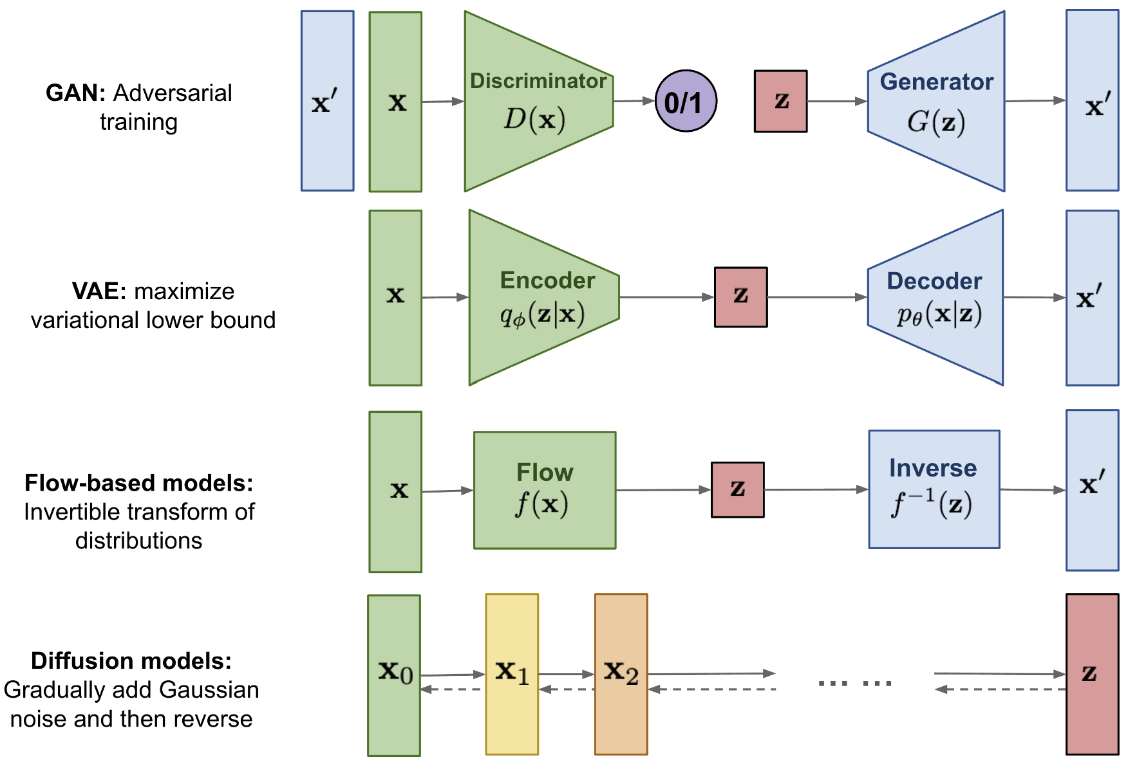
Alternatives to GANs
Lilian Weng’s blog post compares 4 approaches to image generative models

Slide 4
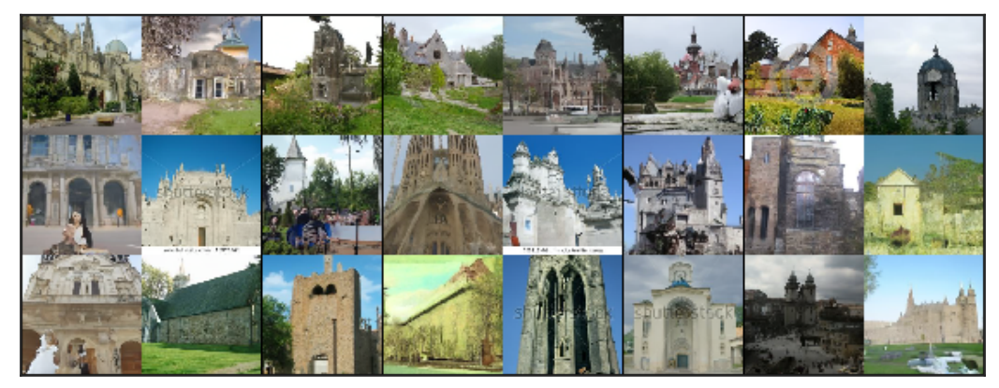
Introduction to Generative Diffusion Models
Images generated by Diffusion Implicit Models, Song, et. al., 2022

Slide 5
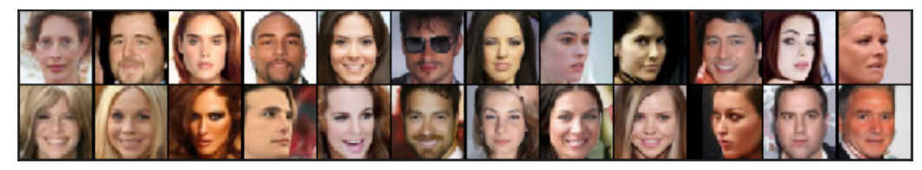
Introduction to Generative Diffusion Models
Images generated by Diffusion Implicit Models, Song, et. al., 2022

Slide 6
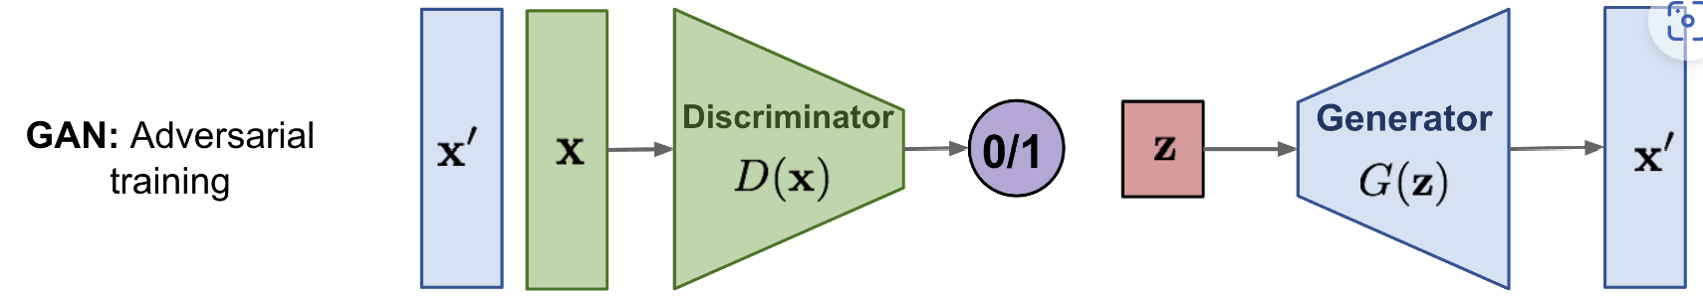
Generative Adversarial Networks, GANs
GANs are known to produce high quality images
A generator creates new data instances starting from random noise
A discriminator attempts to differentiate between actual data instances and generated data
The generator and discriminator engage in a two player non-cooperative zero sum game where the generator attempts to fool the discriminator
Training GANs can be tricky and results can be erratic

Slide 7
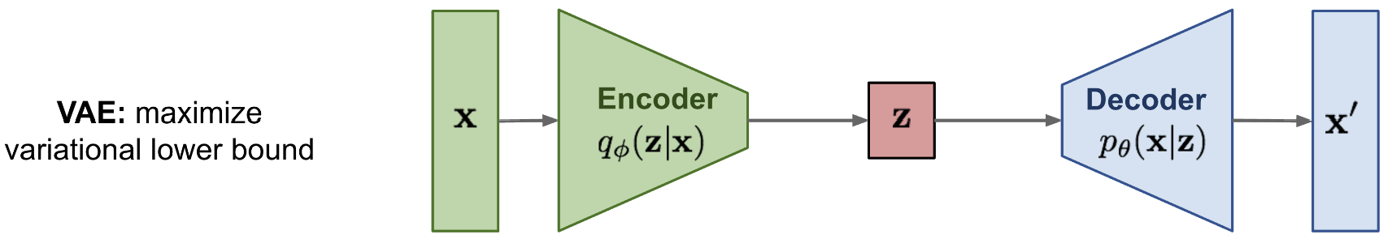
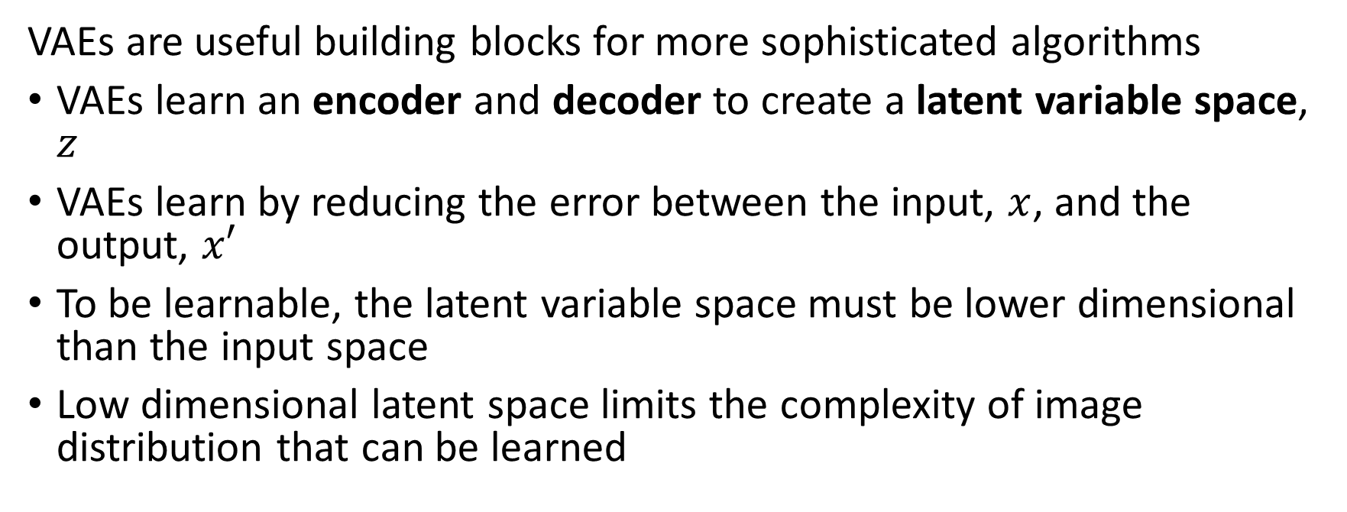
Variational Autoencoders, VAEs
VAEs are useful building blocks for more sophisticated algorithms
VAEs learn an encoder and decoder to create a latent variable space, $z$
VAEs learn by reducing the error between the input, $x$, and the output, $x′$
To be learnable, the latent variable space must be lower dimensional than the input space
Low dimensional latent space limits the complexity of image distribution that can be learned

Slide 8
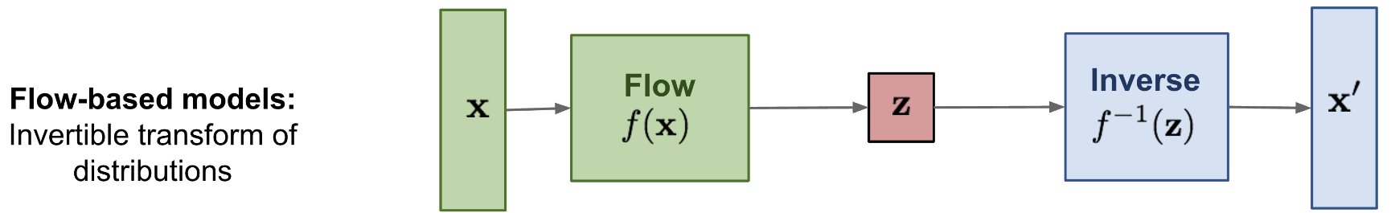
Flow-Based Models
Flow-based models……………………………..
……………..

Slide 9
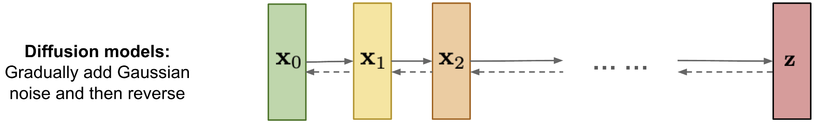
Generative Diffusion Models
More recently generative diffusion models have come to dominate generative image models
The forward diffusion process transforms image to random noise
Diffusion process use small (incremental) steps to simulate a continuous process
Each diffusion step produces a new latent variable (latent space)
Generative diffusion models use a reverse diffusion process to transform a random noise image
Reverse process learned by matching forward process
Diffusion process can be constructed from a long stack of VAEs with simplified model assumptions
Latent space of dimension equal to image space
Approximates complex image distributions

Slide 10
Variational Theory and Evidence Lower Bound

Slide 11
Variational Theory and the Evidence Lower Bound
We can maximize likelihood by optimizing the evidence lower bound (ELBO)
Image data has complex probability distributions
Image generative models must approximate these complex distributions
Finding exact representation of these distributions is an intractable problem
We seek an approximate representation using variational theory
This mathematical method is the basis for deriving VAEs and generative diffusion models

Slide 12
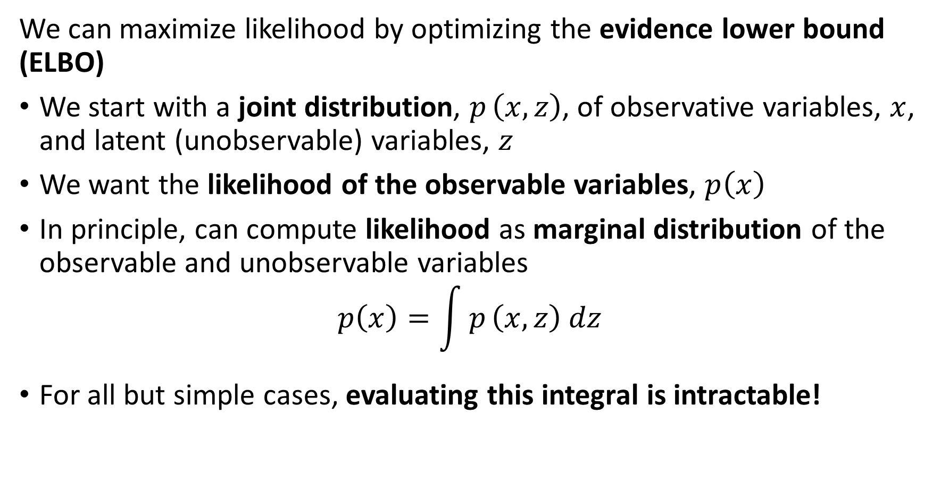
Variational Theory and the Evidence Lower Bound
We can maximize likelihood by optimizing the evidence lower bound (ELBO)
We start with a joint distribution, $p_{ }\left(x,z\right)$, of observative variables, $x$, and latent (unobservable) variables, $z$
We want the likelihood of the observable variables, $p\left(x\right)$
In principle, can compute likelihood as marginal distribution of the observable and unobservable variables
$$p\left(x\right)=\int{p_{ }\left(x,z\right) dz}$$
For all but simple cases, evaluating this integral is intractable!

Slide 13
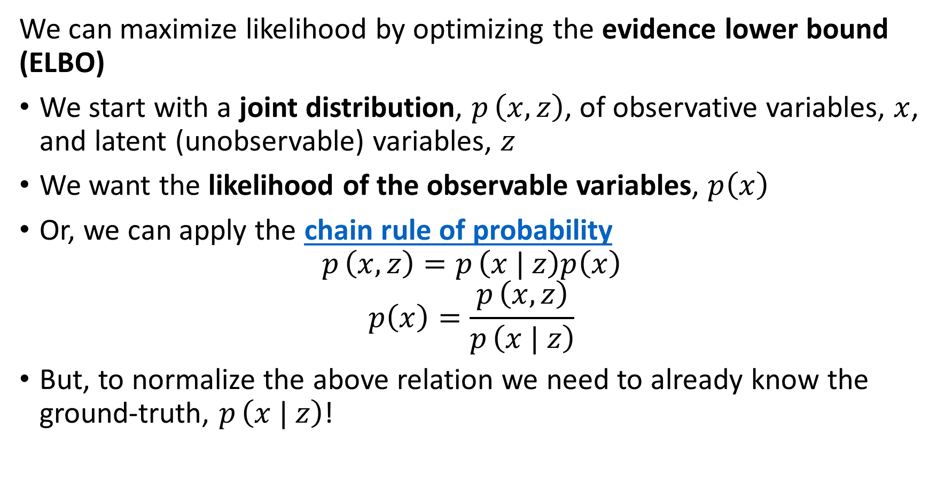
Variational Theory and the Evidence Lower Bound
We can maximize likelihood by optimizing the evidence lower bound (ELBO)
We start with a joint distribution, $p_{ }\left(x,z\right)$, of observative variables, $x$, and latent (unobservable) variables, $z$
We want the likelihood of the observable variables, $p\left(x\right)$
Or, we can apply the chain rule of probability
$$p_{ }\left(x,z\right)=p_{ }\left(x | z\right)p\left(x\right)$$
$$p\left(x\right)=\frac{p_{ }\left(x,z\right)}{p_{ }\left(x | z\right)}$$
But, to normalize the above relation we need to already know the ground-truth, $p_{ }\left(x | z\right)$!

Slide 14
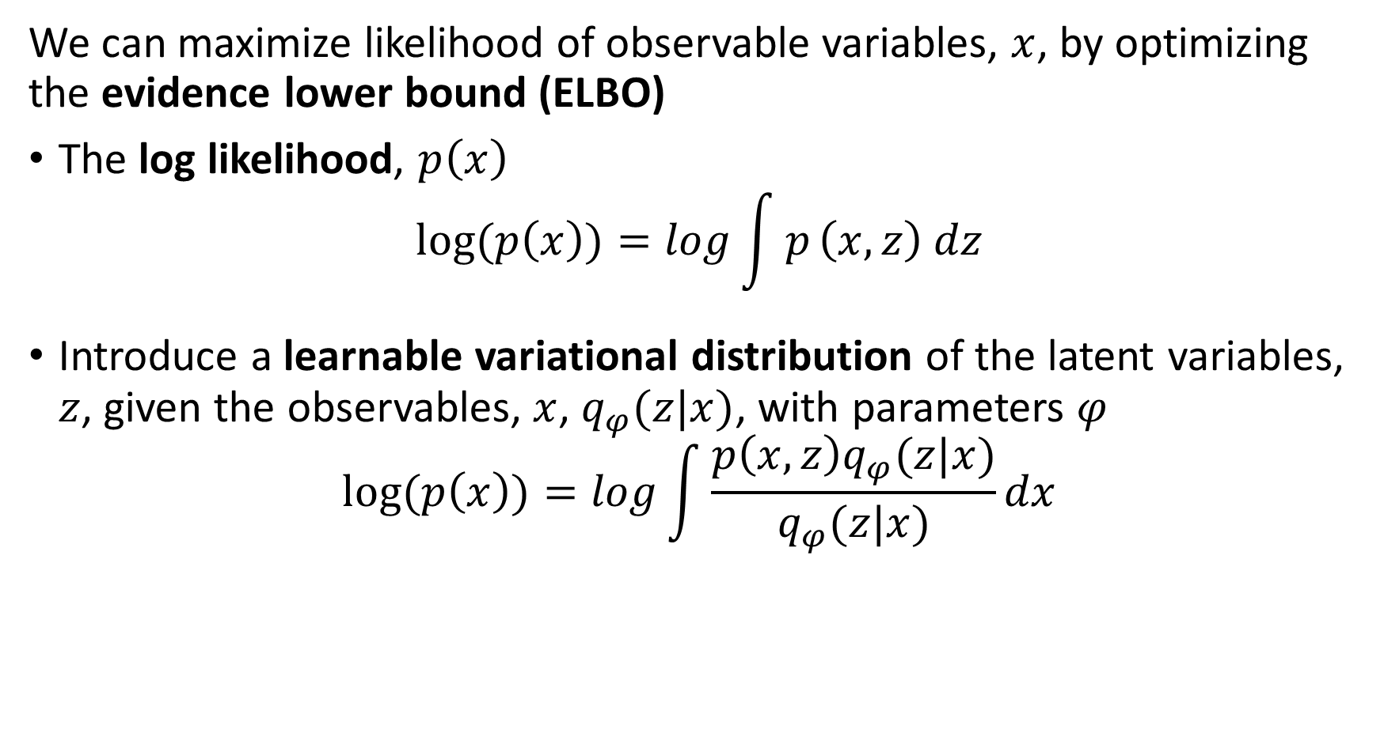
Variational Theory and the Evidence Lower Bound
We can maximize likelihood of observable variables, $x$, by optimizing the evidence lower bound (ELBO)
The log likelihood, $p\left(x\right)$
$$log⁡(p\left(x\right))=log\int{p_{ }\left(x,z\right) dz}$$
Introduce a learnable variational distribution of the latent variables, $z$, given the observables, $x$, $q_{φ}(z|x)$, with parameters $φ$
$$log⁡(p\left(x\right))=log\int{\frac{p\left(x,z\right)q_{φ}(z|x)}{q_{φ}(z|x)}dx}$$

Slide 15
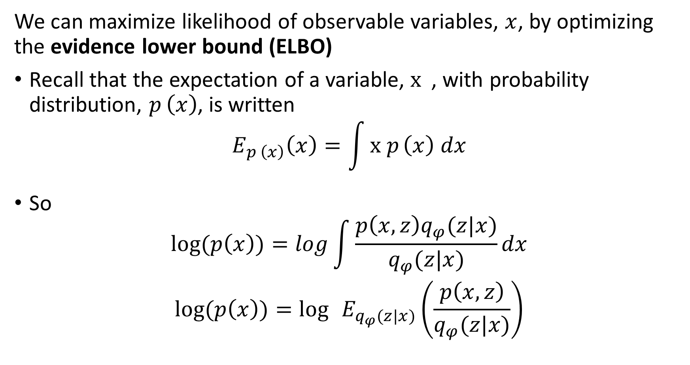
Variational Theory and the Evidence Lower Bound
We can maximize likelihood of observable variables, $x$, by optimizing the evidence lower bound (ELBO)
Recall that the expectation of a variable, ${x }_{ }$, with probability distribution, $p_{ }\left(x\right)$, is written
$$E_{p_{ }\left(x\right)}\left(x\right)=\int{{x p}_{ }\left(x\right) dx}$$
So
$$log⁡(p\left(x\right))=log\int{\frac{p\left(x,z\right)q_{φ}(z|x)}{q_{φ}(z|x)}dx}$$
$$log⁡(p\left(x\right))=\log{ }E_{q_{φ}(z|x)}\left(\frac{p\left(x,z\right)}{q_{φ}(z|x)}\right)$$

Slide 16
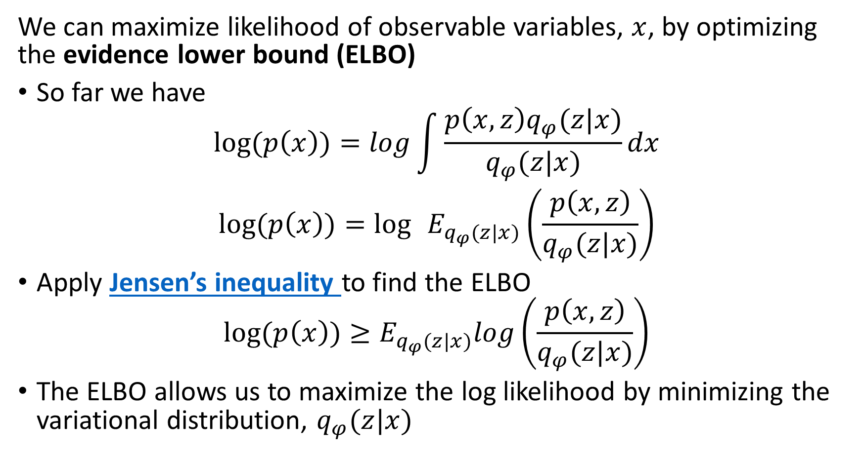
Variational Theory and the Evidence Lower Bound
We can maximize likelihood of observable variables, $x$, by optimizing the evidence lower bound (ELBO)
So far we have
$$log⁡(p\left(x\right))=log\int{\frac{p\left(x,z\right)q_{φ}(z|x)}{q_{φ}(z|x)}dx}$$
$$log⁡(p\left(x\right))=\log{ }E_{q_{φ}(z|x)}\left(\frac{p\left(x,z\right)}{q_{φ}(z|x)}\right)$$
Apply Jensen’s inequality to find the ELBO
$$log⁡(p\left(x\right))≥E_{q_{φ}(z|x)}log\left(\frac{p\left(x,z\right)}{q_{φ}(z|x)}\right)$$
The ELBO allows us to maximize the log likelihood by minimizing the variational distribution, $q_{φ}(z|x)$

Slide 17
Variational Autoencoders

Slide 18
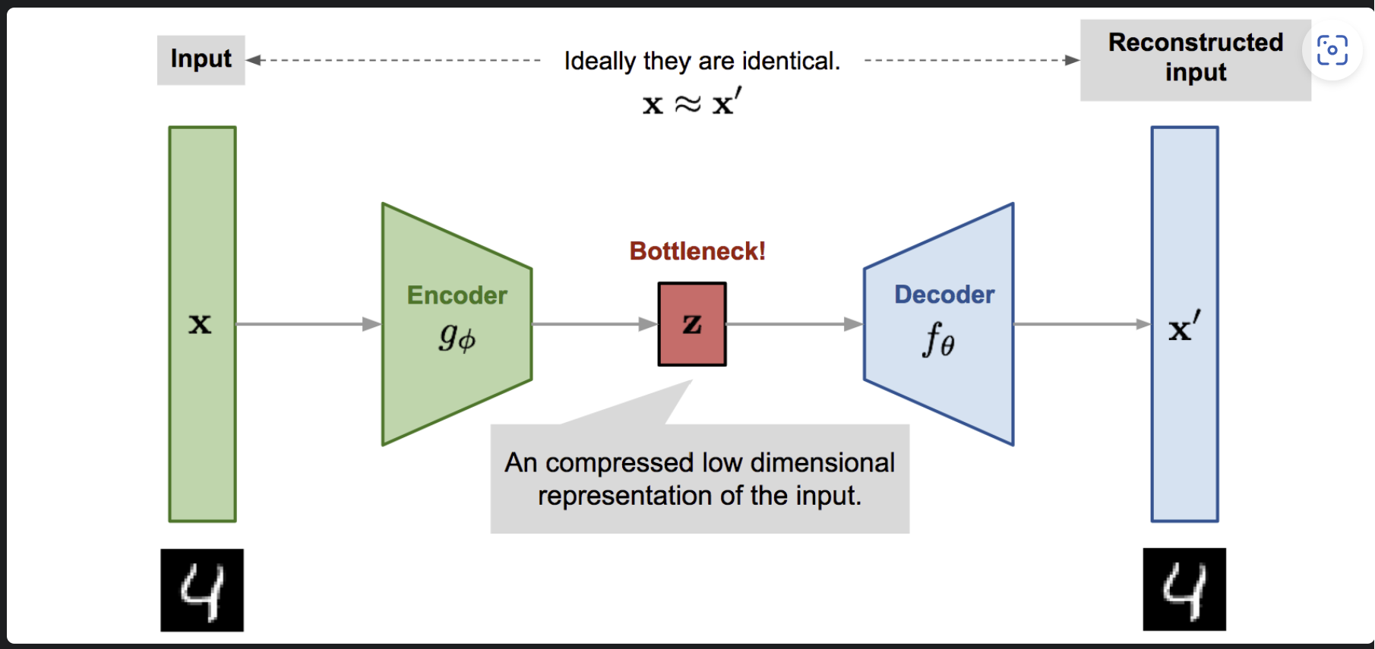
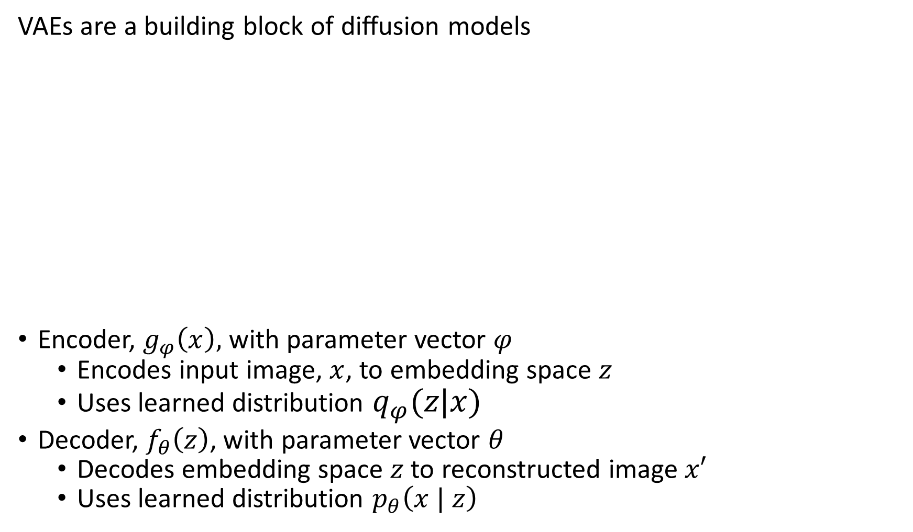
Variational Autoencoders
VAEs are a building block of diffusion models
Encoder, $g_{φ}\left(x\right),$ with parameter vector $φ$
Encodes input image, $x$, to embedding space $z$
Uses learned distribution $q_{φ}(z|x)$
Decoder, $f_{θ}\left(z\right)$, with parameter vector $θ$
Decodes embedding space $z$ to reconstructed image $x′$
Uses learned distribution $p_{θ}\left(x | z\right)$
Image from Lilian Weng’s VAE blog post From Autoencoder to Beta-VAE

Slide 19
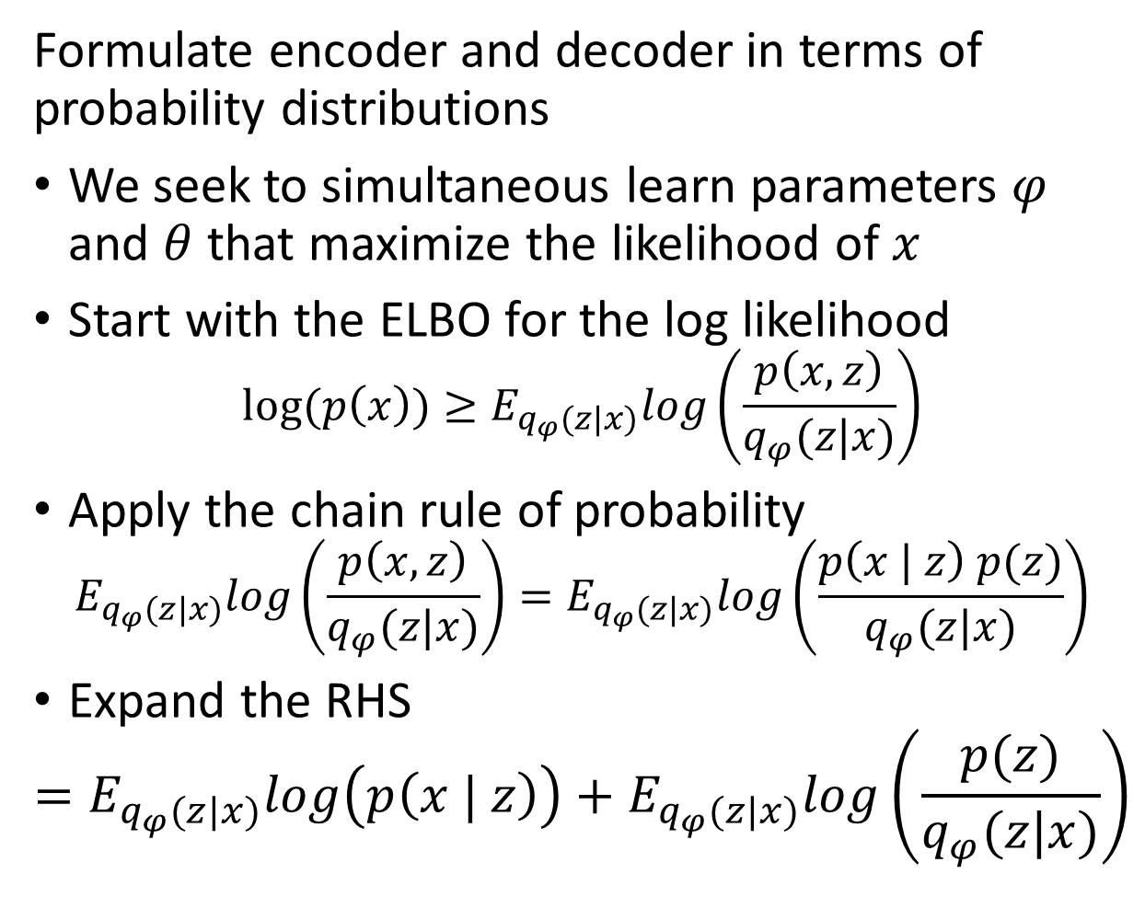
Variational Autoencoders
Formulate encoder and decoder in terms of probability distributions
We seek to simultaneous learn parameters $φ$ and $θ$ that maximize the likelihood of $x$
Start with the ELBO for the log likelihood
$$log⁡(p\left(x\right))≥E_{q_{φ}(z|x)}log\left(\frac{p\left(x,z\right)}{q_{φ}(z|x)}\right)$$
Apply the chain rule of probability
$$E_{q_{φ}(z|x)}log\left(\frac{p\left(x,z\right)}{q_{φ}(z|x)}\right)=E_{q_{φ}(z|x)}log\left(\frac{p\left(x | z\right) p(z)}{q_{φ}(z|x)}\right)$$
Expand the RHS
$$=E_{q_{φ}(z|x)}log\left(p\left(x | z\right)\right)+E_{q_{φ}(z|x)}log\left(\frac{p(z)}{q_{φ}(z|x)}\right)$$
Image from Lilian Weng’s VAE blog post

Slide 20
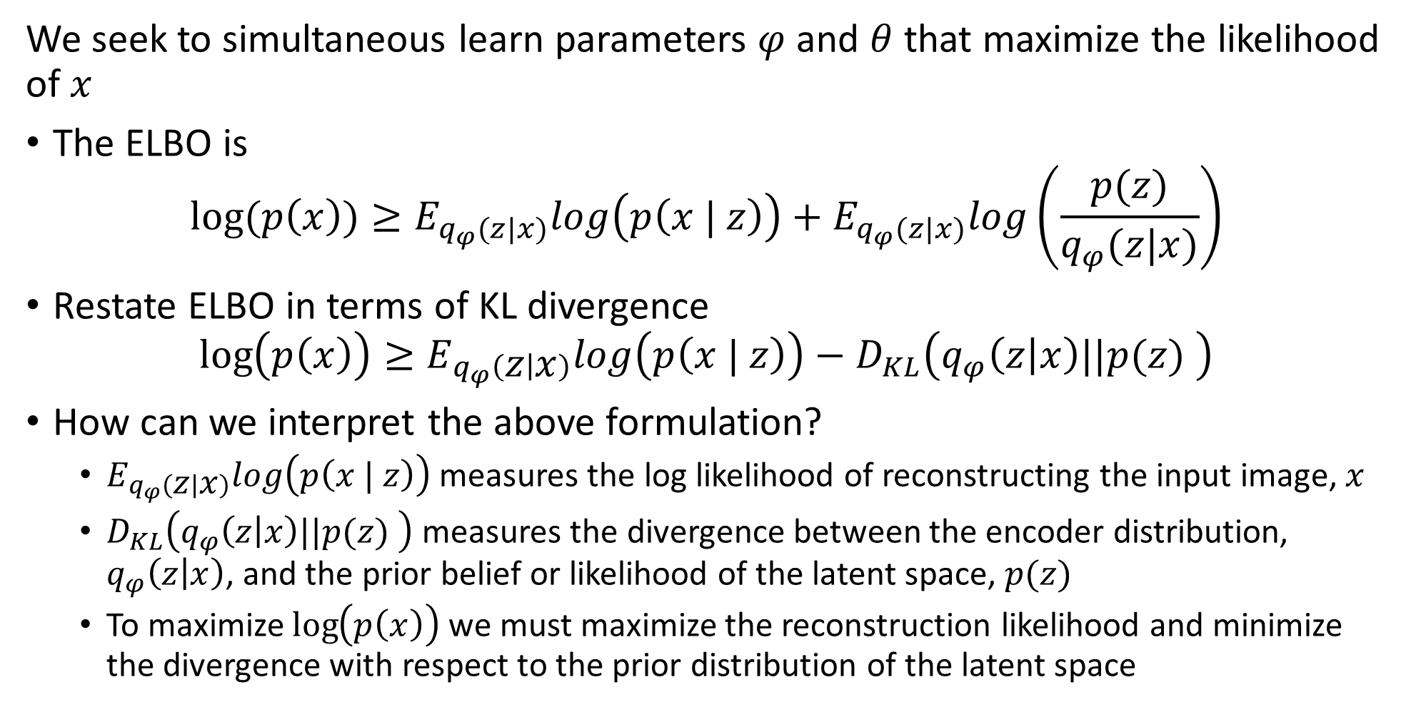
Variational Autoencoders
We seek to simultaneous learn parameters $φ$ and $θ$ that maximize the likelihood of $x$
The ELBO is
$$log⁡(p\left(x\right))≥E_{q_{φ}(z|x)}log\left(p\left(x | z\right)\right)+E_{q_{φ}(z|x)}log\left(\frac{p(z)}{q_{φ}(z|x)}\right)$$
Restate ELBO in terms of KL divergence
$$\log\left(p\left(x\right)\right)≥E_{q_{φ}\left(z | x\right)}log\left(p\left(x | z\right)\right)−D_{KL}\left(q_{φ}\left(z | x\right)||p(z) \right)$$
How can we interpret the above formulation?
$E_{q_{φ}\left(z | x\right)}log\left(p\left(x | z\right)\right)$ measures the log likelihood of reconstructing the input image, $x$
$D_{KL}\left(q_{φ}\left(z | x\right)||p(z) \right)$ measures the divergence between the encoder distribution, $q_{φ}\left(z | x\right)$, and the prior belief or likelihood of the latent space, $p(z)$
To maximize $\log\left(p\left(x\right)\right)$ we must maximize the reconstruction likelihood and minimize the divergence with respect to the prior distribution of the latent space

Slide 21
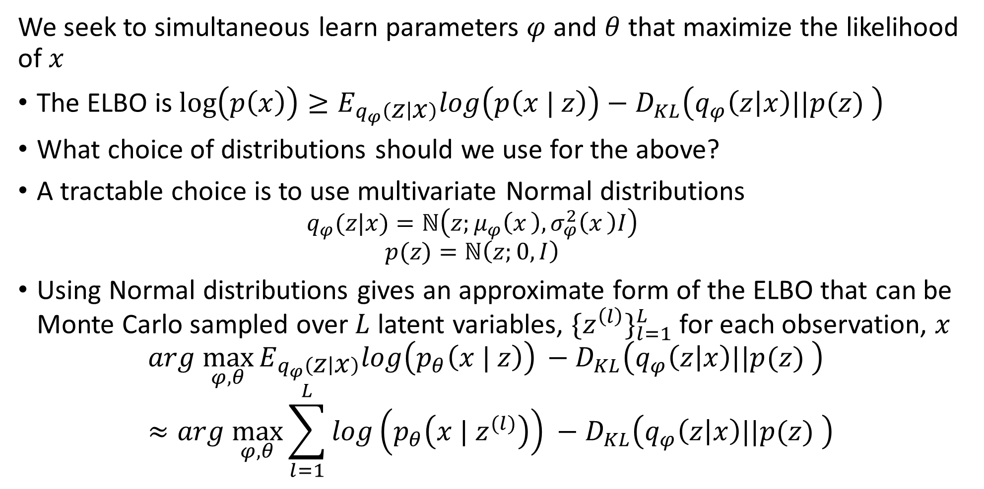
Variational Autoencoders
We seek to simultaneous learn parameters $φ$ and $θ$ that maximize the likelihood of $x$
The ELBO is $\log\left(p\left(x\right)\right)≥E_{q_{φ}\left(z | x\right)}log\left(p\left(x | z\right)\right)−D_{KL}\left(q_{φ}\left(z | x\right)||p(z) \right)$
What choice of distributions should we use for the above?
A tractable choice is to use multivariate Normal distributions
$$q_{φ}(z|x)=ℕ\left(z;μ_{φ}\left(x_{ }\right),σ_{φ}^{2}\left(x_{ }\right)I\right)$$
$$p(z)=ℕ\left(z;0, I\right)$$
Using Normal distributions gives an approximate form of the ELBO that can be Monte Carlo sampled over $L$ latent variables, ${\{z^{\left(l\right)}\}}_{l=1}^{L}$ for each observation, $x$
$${arg \max_{φ,θ}{E_{q_{φ}\left(z | x\right)}log\left(p_{θ}\left(x | z\right)\right)}}_{ }−D_{KL}\left(q_{φ}\left(z | x\right)||p(z) \right)≈{arg \max_{φ,θ}{\sum_{l=1}^{L}{log\left(p_{θ}\left(x | z^{(l)}\right)\right)}}}_{ }−D_{KL}\left(q_{φ}\left(z | x\right)||p(z) \right)$$

Slide 22
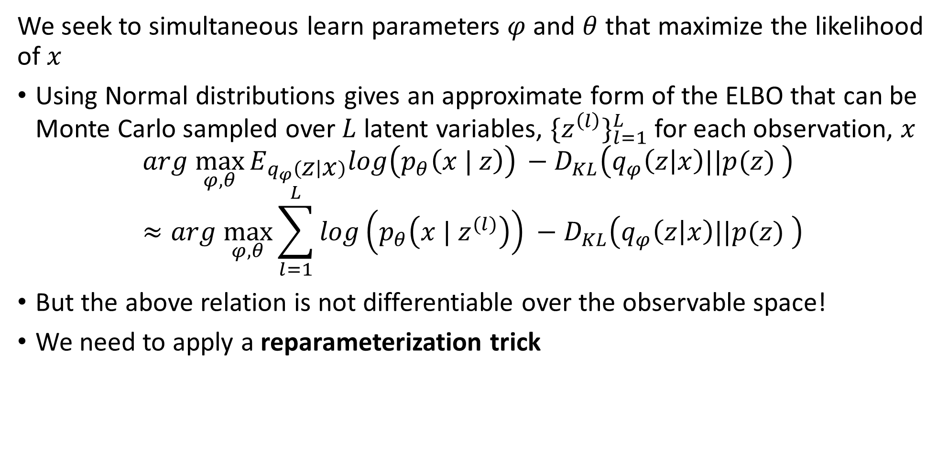
Variational Autoencoders
We seek to simultaneous learn parameters $φ$ and $θ$ that maximize the likelihood of $x$
Using Normal distributions gives an approximate form of the ELBO that can be Monte Carlo sampled over $L$ latent variables, ${\{z^{\left(l\right)}\}}_{l=1}^{L}$ for each observation, $x$
$${arg \max_{φ,θ}{E_{q_{φ}\left(z | x\right)}log\left(p_{θ}\left(x | z\right)\right)}}_{ }−D_{KL}\left(q_{φ}\left(z | x\right)||p(z) \right)≈{arg \max_{φ,θ}{\sum_{l=1}^{L}{log\left(p_{θ}\left(x | z^{(l)}\right)\right)}}}_{ }−D_{KL}\left(q_{φ}\left(z | x\right)||p(z) \right)$$
But the above relation is not differentiable over the observable space!
We need to apply a reparameterization trick

Slide 23
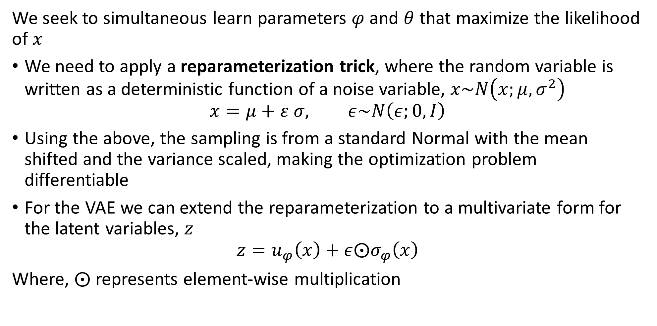
Variational Autoencoders
We seek to simultaneous learn parameters $φ$ and $θ$ that maximize the likelihood of $x$
We need to apply a reparameterization trick, where the random variable is written as a deterministic function of a noise variable, $x\sim N\left(x;μ,σ^{2}\right)$
$$x=μ+ε σ, ε\sim N\left(ε;0,I\right)$$
Using the above, the sampling is from a standard Normal with the mean shifted and the variance scaled, making the optimization problem differentiable
For the VAE we can extend the reparameterization to a multivariate form for the latent variables, $z$
$$z=u_{φ}\left(x\right)+ε⨀σ_{φ}\left(x\right)$$
Where, $⨀$ represents element-wise multiplication

Slide 24
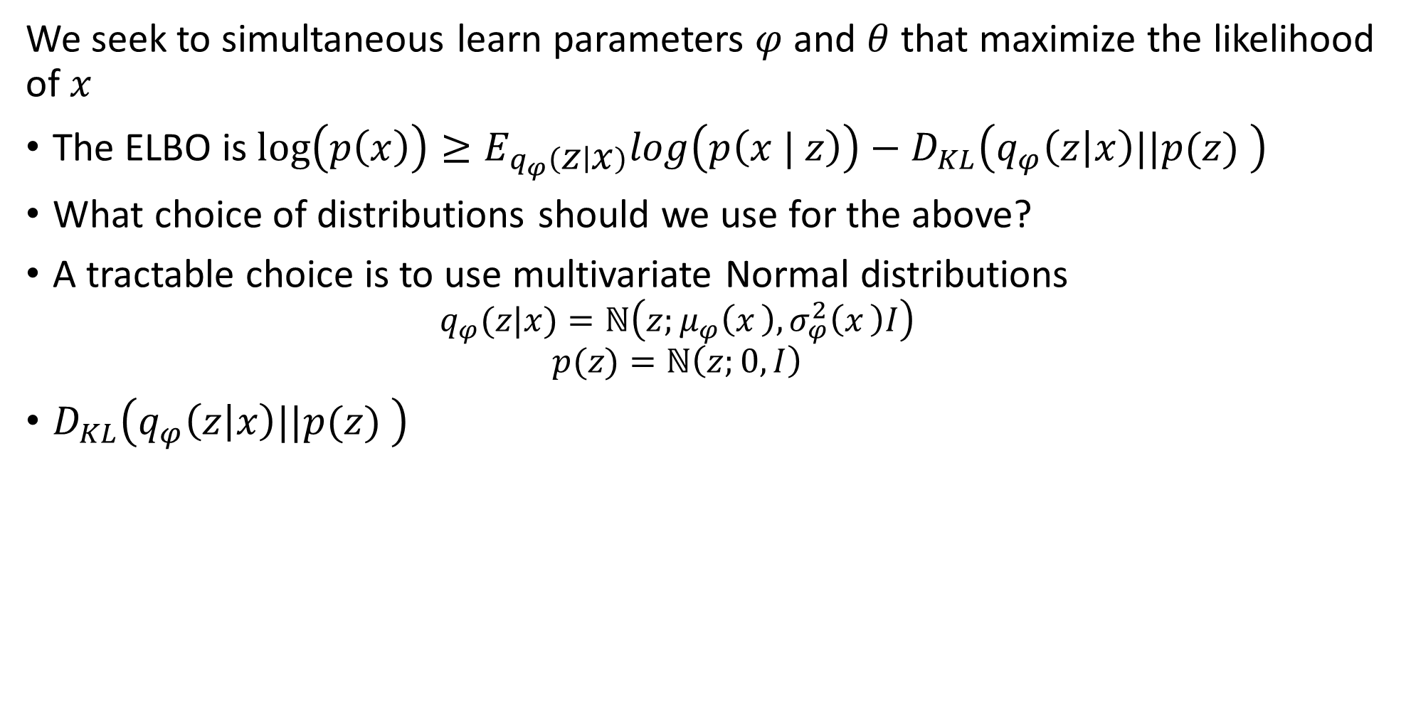
Variational Autoencoders
We seek to simultaneous learn parameters $φ$ and $θ$ that maximize the likelihood of $x$
The ELBO is $\log\left(p\left(x\right)\right)≥E_{q_{φ}\left(z | x\right)}log\left(p\left(x | z\right)\right)−D_{KL}\left(q_{φ}\left(z | x\right)||p(z) \right)$
What choice of distributions should we use for the above?
A tractable choice is to use multivariate Normal distributions
$$q_{φ}(z|x)=ℕ\left(z;μ_{φ}\left(x_{ }\right),σ_{φ}^{2}\left(x_{ }\right)I\right)$$
$$p(z)=ℕ\left(z;0, I\right)$$
$D_{KL}\left(q_{φ}\left(z | x\right)||p(z) \right)$

Slide 25
Forward and Reverse Diffusion Processes

Slide 26
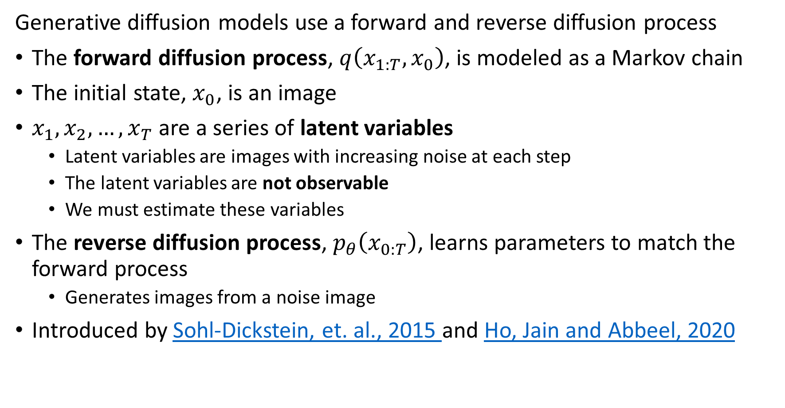
Diffusion Processes
Generative diffusion models use a forward and reverse diffusion process
The forward diffusion process, $q\left(x_{1:T},x_{0}\right)$, is modeled as a Markov chain
The initial state, $x_{0}$, is an image
$x_{1},x_{2},…,x_{T}$ are a series of latent variables
Latent variables are images with increasing noise at each step
The latent variables are not observable
We must estimate these variables
The reverse diffusion process, $p_{θ}\left(x_{0:T}\right)$, learns parameters to match the forward process
Generates images from a noise image
Introduced by Sohl-Dickstein, et. al., 2015 and Ho, Jain and Abbeel, 2020

Slide 27
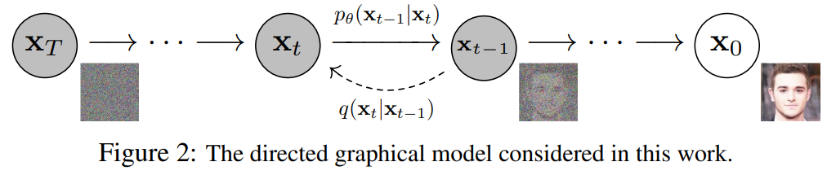
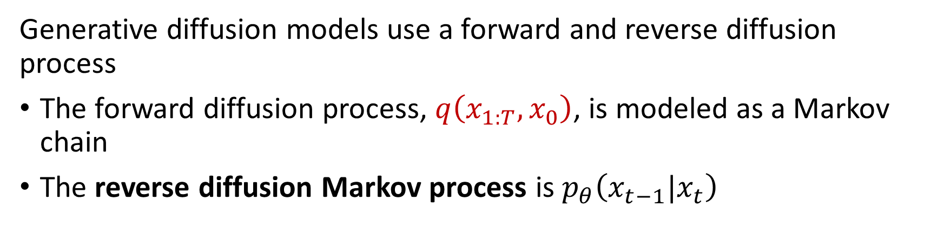
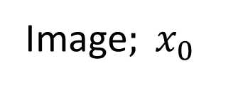
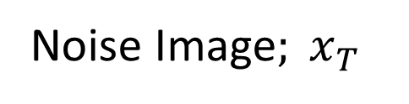
Diffusion Processes
Generative diffusion models use a forward and reverse diffusion process
The forward diffusion process, $q\left(x_{1:T},x_{0}\right)$, is modeled as a Markov chain
The reverse diffusion Markov process is $p_{θ}\left(x_{t−1}|x_{t}\right)$
Noise Image$; x_{T}$
Image$; x_{0}$

Slide 28
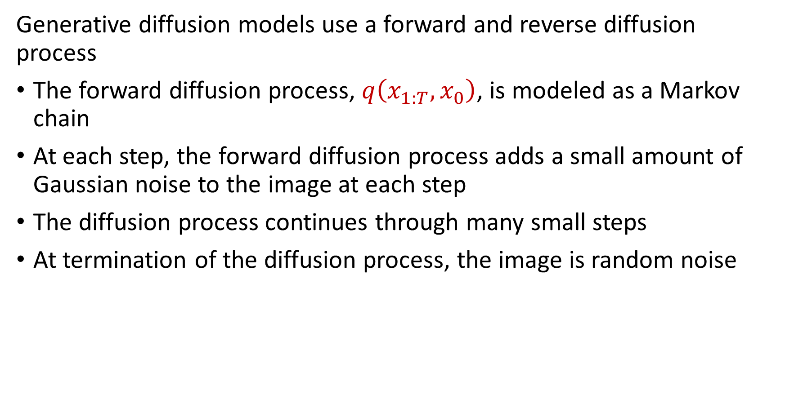
Diffusion Processes
Generative diffusion models use a forward and reverse diffusion process
The forward diffusion process, $q\left(x_{1:T},x_{0}\right)$, is modeled as a Markov chain
At each step, the forward diffusion process adds a small amount of Gaussian noise to the image at each step
The diffusion process continues through many small steps
At termination of the diffusion process, the image is random noise

Slide 29
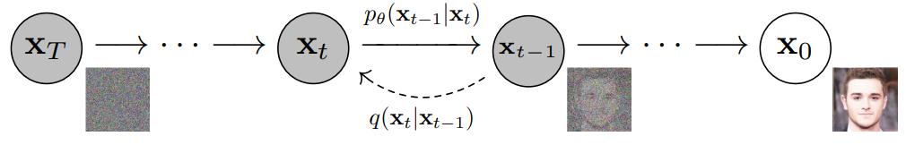
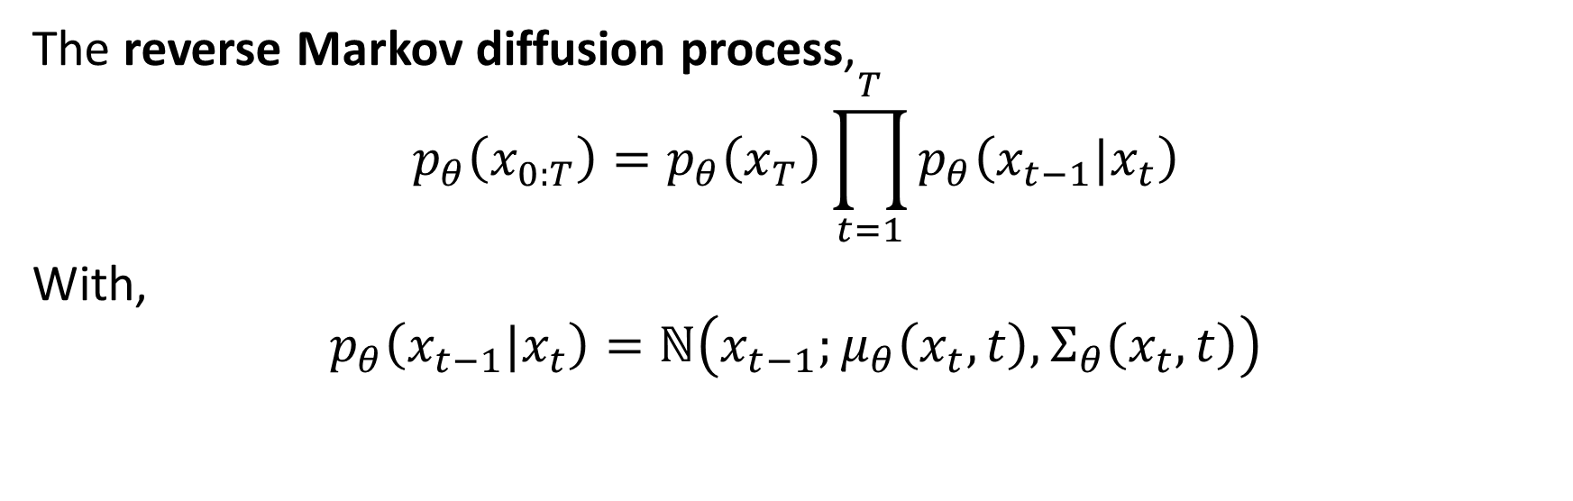
Diffusion Processes
Generative diffusion models use a forward and reverse diffusion process
The reverse Markov diffusion process,
$$p_{θ}\left(x_{0:T}\right)=p_{θ}\left(x_{T}\right)\prod_{t=1}^{T}{p_{θ}\left(x_{t−1}|x_{t}\right)}$$
With,
$$p_{θ}\left(x_{t−1}|x_{t}\right)=ℕ\left(x_{t−1};μ_{θ}\left(x_{t},t\right),Σ_{θ}\left(x_{t},t\right)\right)$$

Slide 30
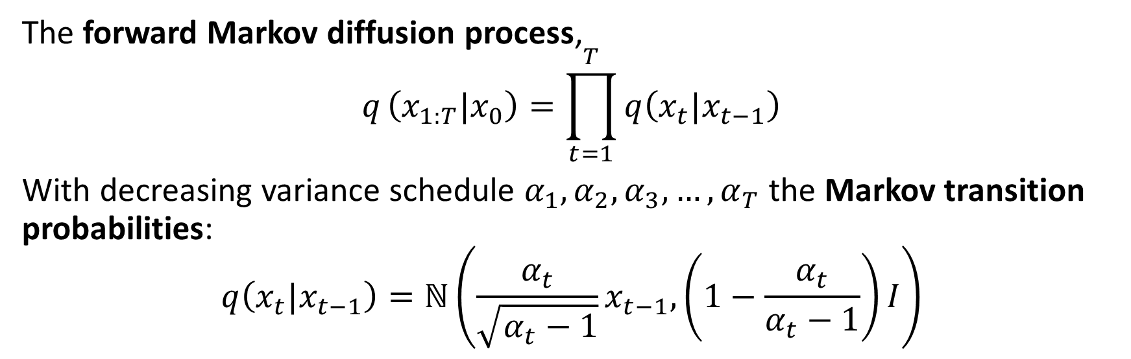
Diffusion Processes
Generative diffusion models use a forward and reverse diffusion process
The forward Markov diffusion process,
$$q_{ }\left(x_{1:T}|x_{0}\right)=\prod_{t=1}^{T}{q\left(x_{t}|x_{t−1}\right)}$$
With decreasing variance schedule $α_{1},α_{2},α_{3},…,α_{T}$ the Markov transition probabilities:
$$q\left(x_{t}|x_{t−1}\right)=ℕ\left(\frac{α_{t}}{\sqrt{α_{t}−1}}x_{t−1}, \left(1−\frac{α_{t}}{α_{t}−1}\right)I\right)$$

Slide 31
Variational Approximation

Slide 32
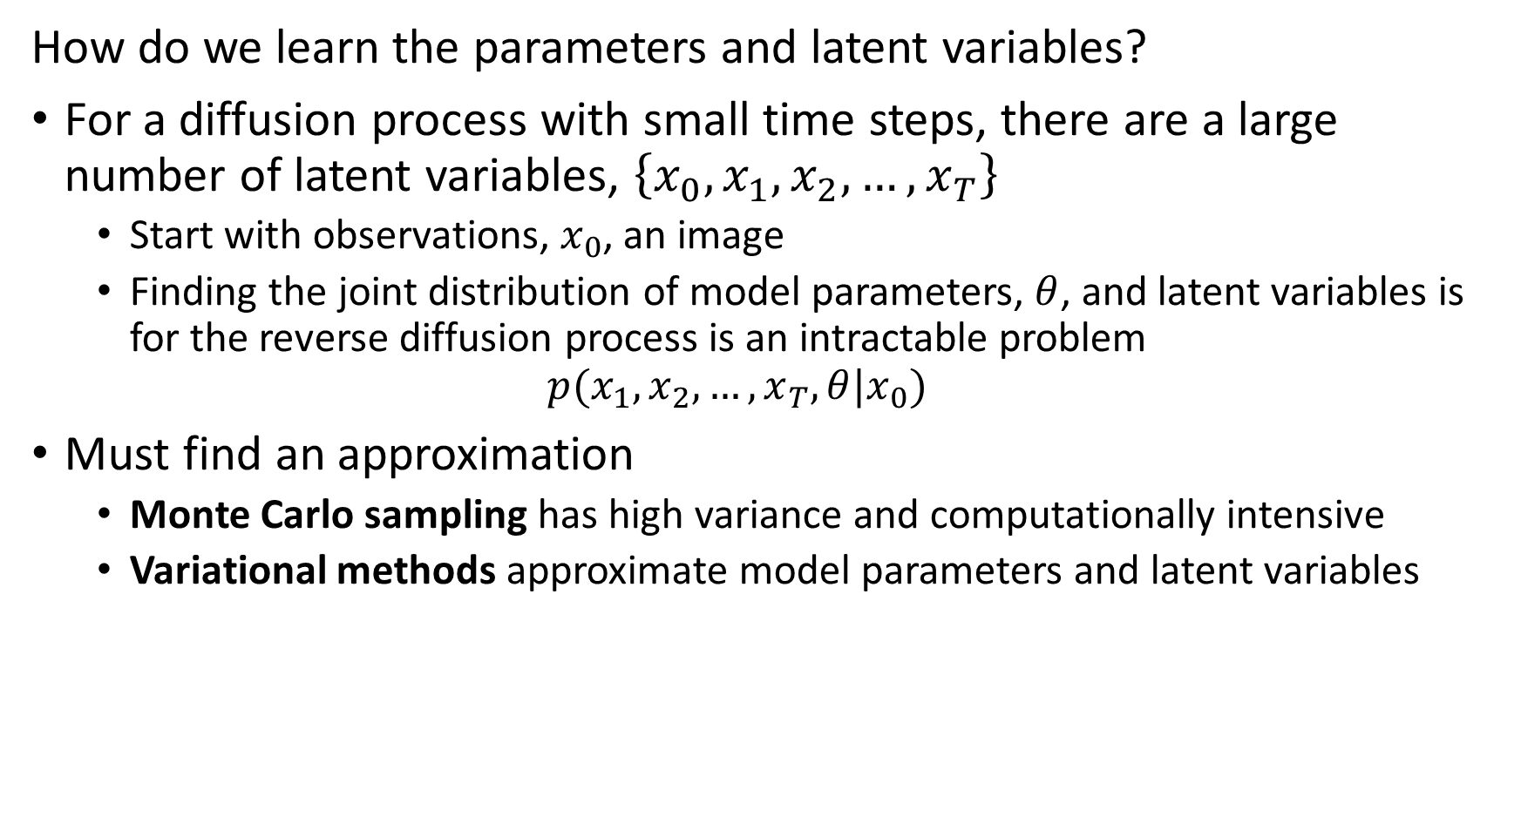
Variational Approximation
How do we learn the parameters and latent variables?
For a diffusion process with small time steps, there are a large number of latent variables, $\left\{x_{0},x_{1},x_{2},…,x_{T}\right\}$
Start with observations, $x_{0}$, an image
Finding the joint distribution of model parameters, $θ$, and latent variables is for the reverse diffusion process is an intractable problem
$$p(x_{1},x_{2},…,x_{T},θ|x_{0})$$
Must find an approximation
Monte Carlo sampling has high variance and computationally intensive
Variational methods approximate model parameters and latent variables

Slide 33
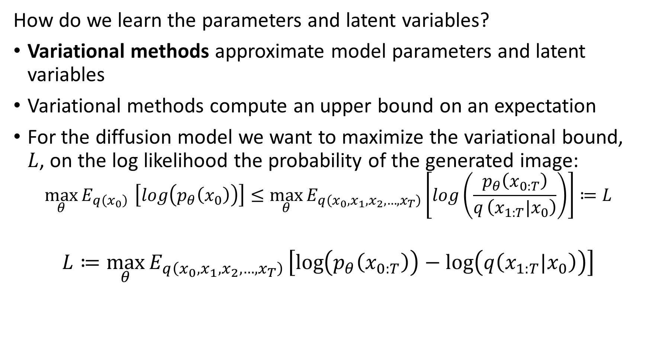
Variational Approximation
How do we learn the parameters and latent variables?
Variational methods approximate model parameters and latent variables
Variational methods compute an upper bound on an expectation
For the diffusion model we want to maximize the variational bound, $L$, on the log likelihood the probability of the generated image:
$${\max_{θ}{E_{q\left(x_{0}\right)}}}_{ }\left[log\left(p_{θ}\left(x_{0}\right)\right)\right]≤\max_{θ}{E_{q\left(x_{0},x_{1},x_{2},…,x_{T}\right)}}\left[log\left(\frac{p_{θ}\left(x_{0:T}\right)}{q_{ }\left(x_{1:T}|x_{0}\right)}\right)\right]≔L$$
$$L≔\max_{θ}{E_{q\left(x_{0},x_{1},x_{2},…,x_{T}\right)}}\left[\log\left(p_{θ}\left(x_{0:T}\right)\right)−\log\left(q\left(x_{1:T}|x_{0}\right)\right)\right]$$

Slide 34
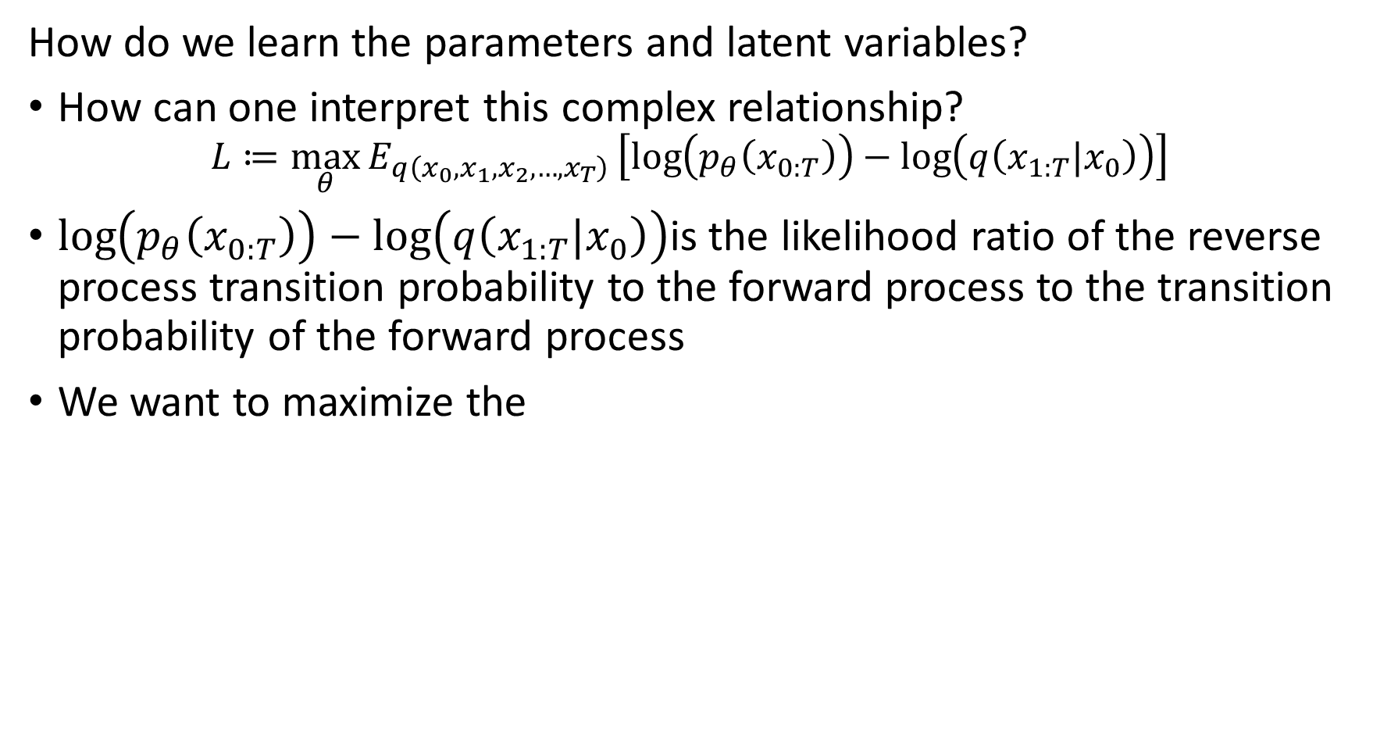
Variational Approximation
How do we learn the parameters and latent variables?
How can one interpret this complex relationship?
$$L≔\max_{θ}{E_{q\left(x_{0},x_{1},x_{2},…,x_{T}\right)}}\left[\log\left(p_{θ}\left(x_{0:T}\right)\right)−\log\left(q\left(x_{1:T}|x_{0}\right)\right)\right]$$
$\log\left(p_{θ}\left(x_{0:T}\right)\right)−\log\left(q\left(x_{1:T}|x_{0}\right)\right)$is the likelihood ratio of the reverse process transition probability to the forward process to the transition probability of the forward process
We want to maximize the

Slide 35
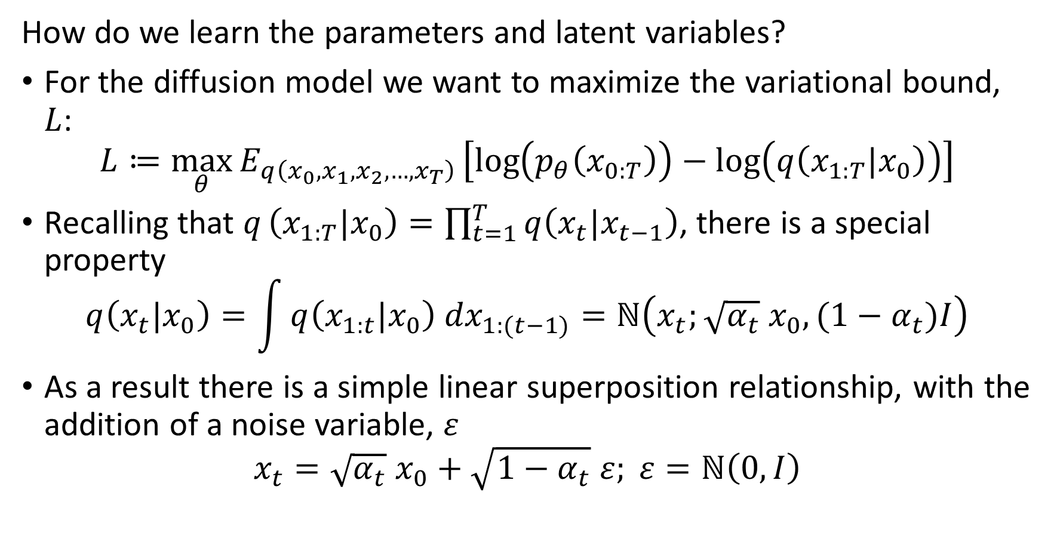
Variational Approximation
How do we learn the parameters and latent variables?
For the diffusion model we want to maximize the variational bound, $L$:
$$L≔\max_{θ}{E_{q\left(x_{0},x_{1},x_{2},…,x_{T}\right)}}\left[\log\left(p_{θ}\left(x_{0:T}\right)\right)−\log\left(q\left(x_{1:T}|x_{0}\right)\right)\right]$$
Recalling that $q_{ }\left(x_{1:T}|x_{0}\right)=\prod_{t=1}^{T}{q\left(x_{t}|x_{t−1}\right)}$, there is a special property
$$q\left(x_{t}|x_{0}\right)=\int_{ }^{ }{q\left(x_{1:t}|x_{0}\right){ dx}_{1:(t−1)}}=ℕ\left(x_{t};{\sqrt{α_{t}} x}_{0},(1−α_{t})I\right)$$
As a result there is a simple linear superposition relationship, with the addition of a noise variable, $ε$
$$x_{t}={\sqrt{α_{t}} x}_{0}+\sqrt{{1−α}_{t}} ε; ε=ℕ\left(0,I\right)$$

Slide 36
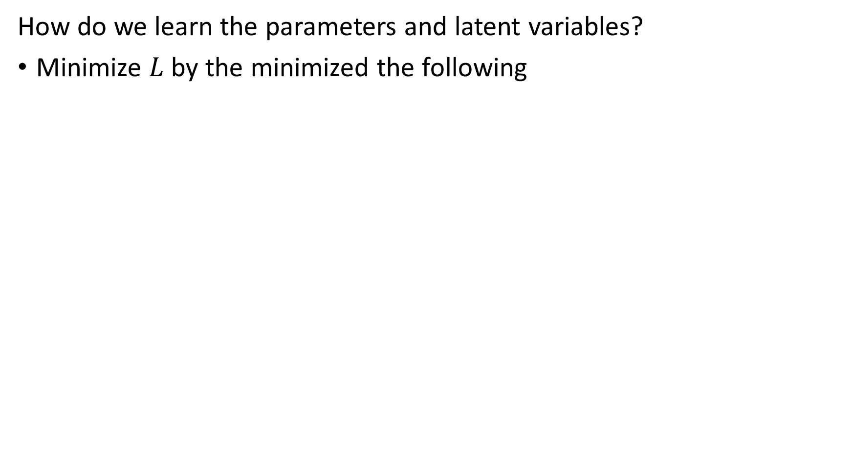
Variational Approximation
How do we learn the parameters and latent variables?
Minimize $L$ by the minimized the following

Slide 37
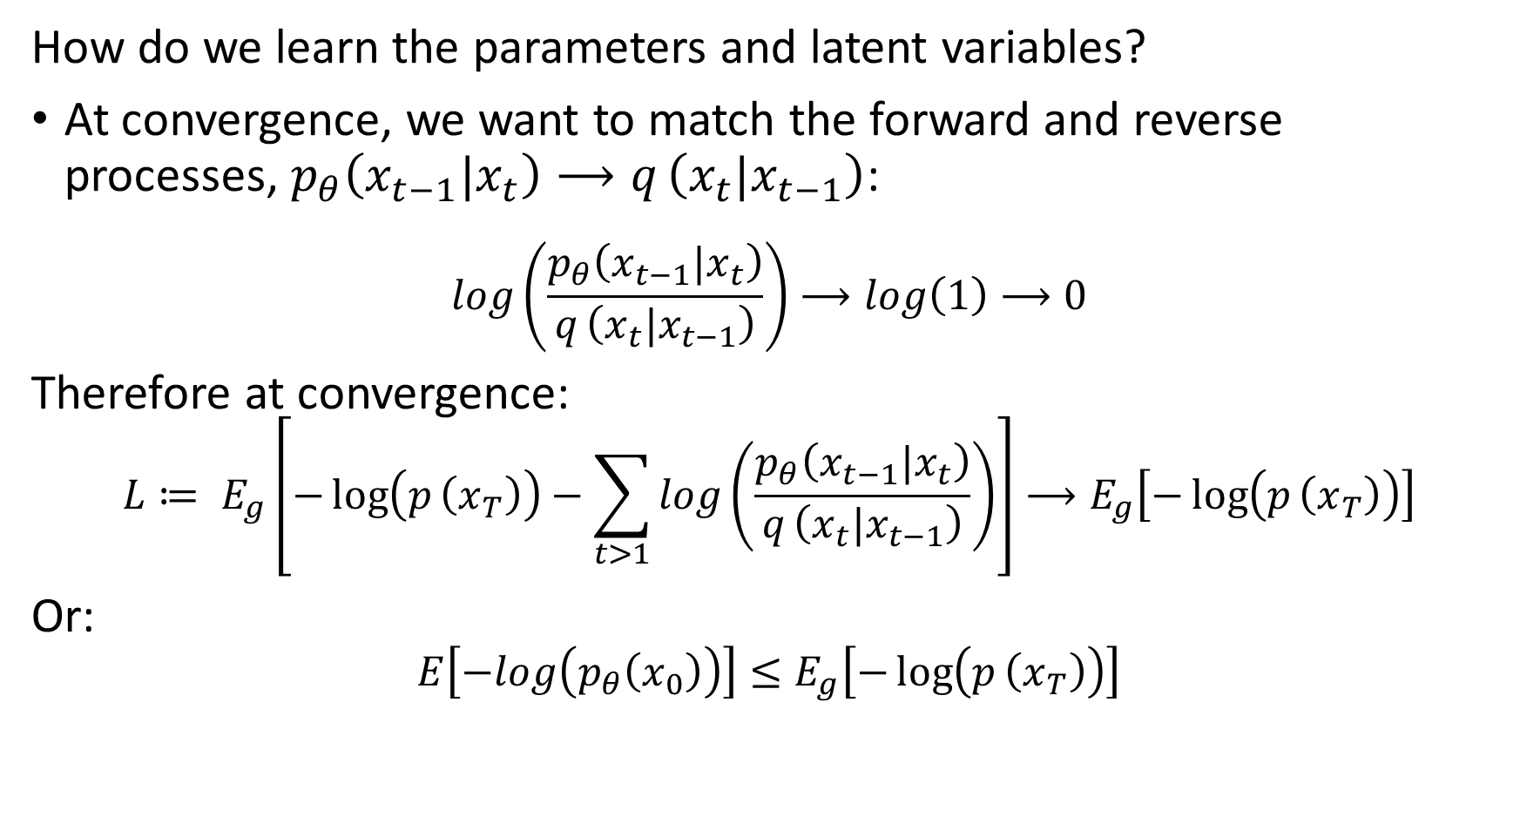
Variational Approximation
How do we learn the parameters and latent variables?
At convergence, we want to match the forward and reverse processes, $p_{θ}\left(x_{t−1}|x_{t}\right)⟶q_{ }\left(x_{t}|x_{t−1}\right)$:
$$log\left(\frac{p_{θ}\left(x_{t−1}|x_{t}\right)}{q_{ }\left(x_{t}|x_{t−1}\right)}\right)⟶log\left(1\right)⟶0$$
Therefore at convergence:
$$L≔ E_{g}\left[−\log\left(p_{ }\left(x_{T}\right)\right)−\sum_{t>1}^{ }{log\left(\frac{p_{θ}\left(x_{t−1}|x_{t}\right)}{q_{ }\left(x_{t}|x_{t−1}\right)}\right)}\right]⟶E_{g}\left[−\log\left(p_{ }\left(x_{T}\right)\right)\right]$$
Or:
$$E\left[−log\left(p_{θ}\left(x_{0}\right)\right)\right]≤E_{g}\left[−\log\left(p_{ }\left(x_{T}\right)\right)\right]$$

Slide 38
Loss Functions for GANs

Slide 39
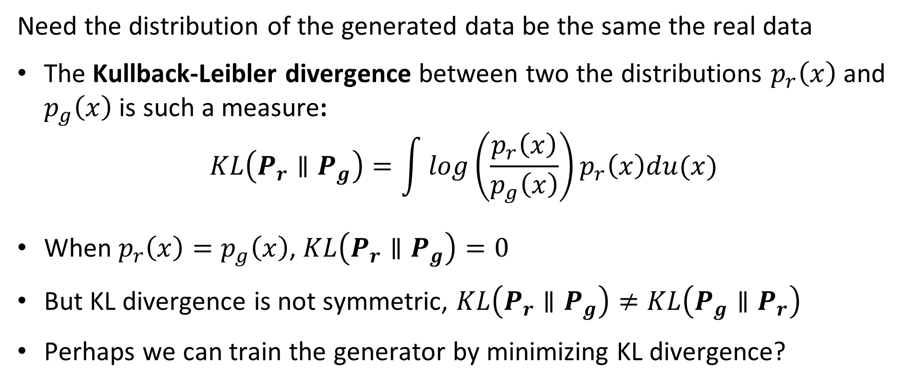
Loss Functions for Training Neural Networks
Need the distribution of the generated data be the same the real data
The Kullback-Leibler divergence between two the distributions $p_{r}\left(x\right)$ and $p_{g}\left(x\right)$ is such a measure:
$$KL\left(P_{r}∥P_{g}\right)=\int{log\left(\frac{p_{r}\left(x\right)}{p_{g}\left(x\right)}\right)}p_{r}\left(x\right)du(x)$$
When $p_{r}\left(x\right)=p_{g}\left(x\right)$, $KL\left(P_{r}∥P_{g}\right)=0$
But KL divergence is not symmetric, $KL\left(P_{r}∥P_{g}\right)≠KL\left(P_{g}∥P_{r}\right)$
Perhaps we can train the generator by minimizing KL divergence?

Slide 40
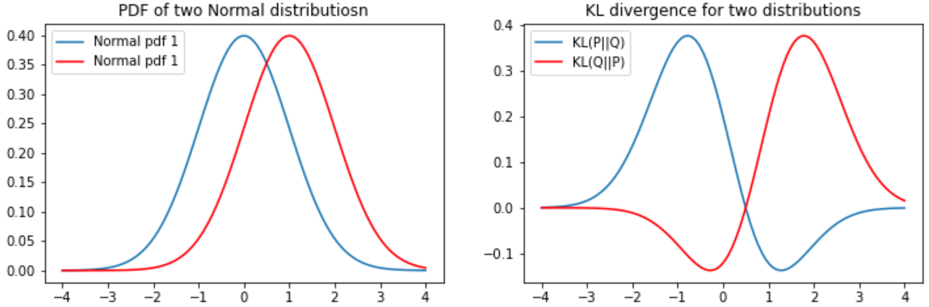
Loss Functions for Training Neural Networks
The KL divergence is asymmetric
For two distributions the KL divergence depend on the order or arguments
Notice that the gradient becomes near zero on one side of the KL function

Slide 41
The Wasserstein distance metric
The Wasserstein distance metric is symmetric and intuitive
The Wasserstein distance metric symmetric with bounded gradients
Wasserstein GAN, or W-GAN (Arjovsky, et. al. 2017) uses the Wasserstein distance as a loss function
Using the Wasserstein loss helps W-GANs avoid mode collapse

Slide 42
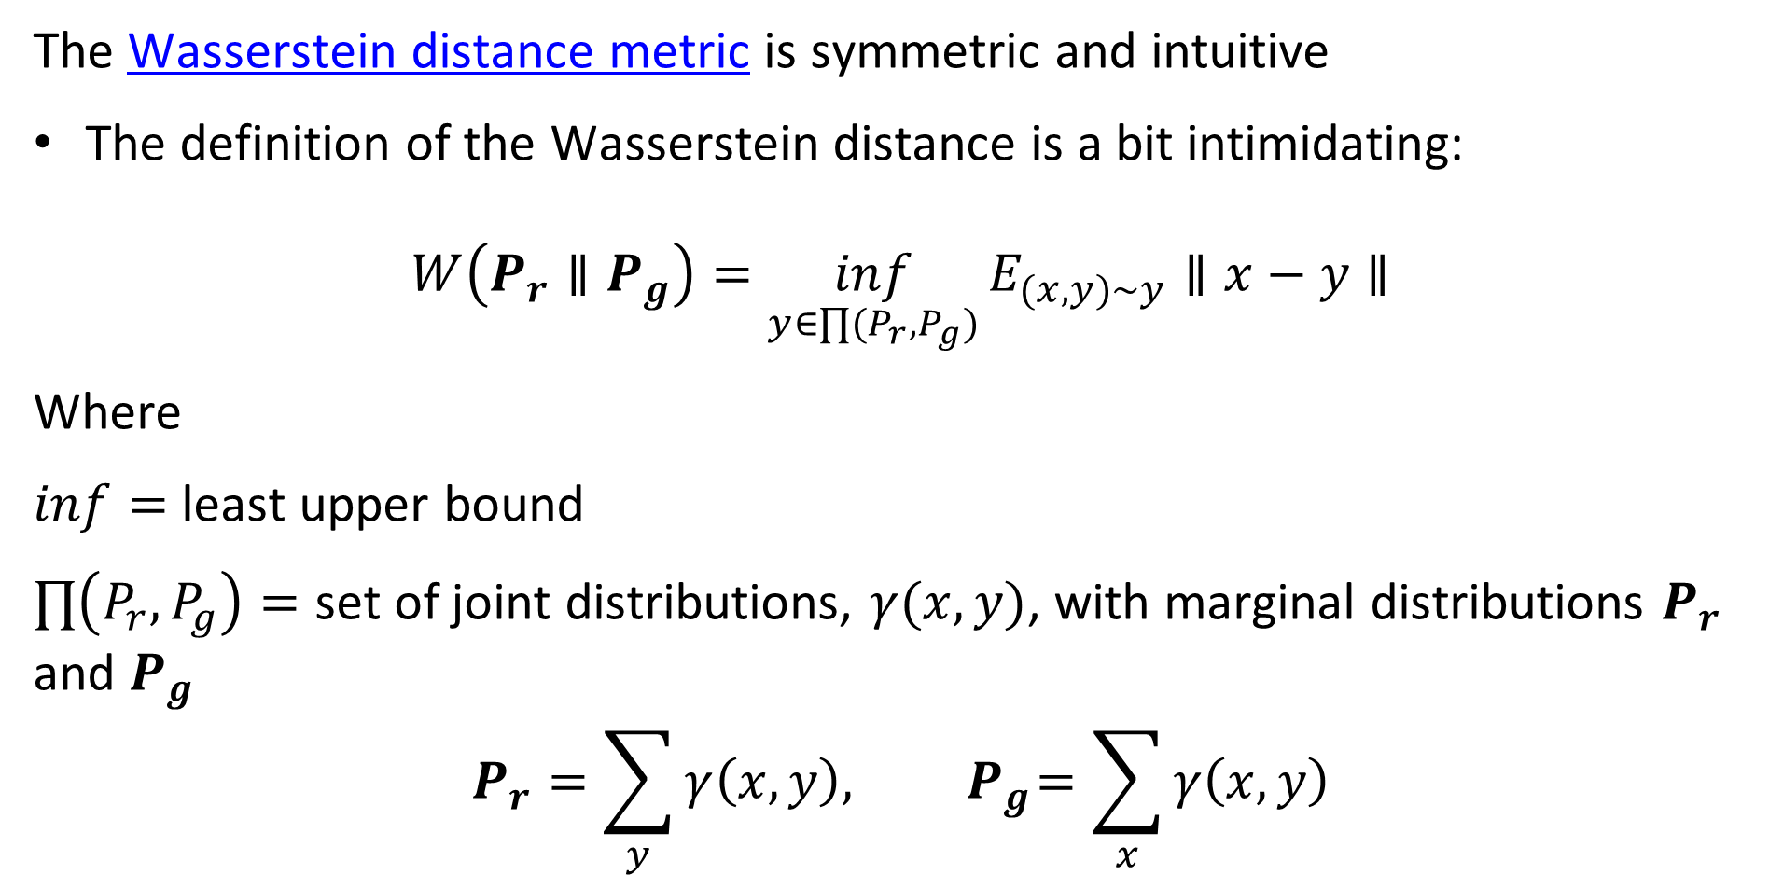
The Wasserstein distance metric
The Wasserstein distance metric is symmetric and intuitive
The definition of the Wasserstein distance is a bit intimidating:
$$W\left(P_{r}∥P_{g}\right)=\inf_{y∈∏(P_{r},P_{g})}{E_{(x,y)∼y}∥x−y∥}$$
Where
$inf=$ least upper bound
$∏\left(P_{r},P_{g}\right)=$ set of joint distributions, $γ(x,y)$, with marginal distributions $P_{r}$ and $P_{g}$
$$P_{r}=\sum_{y}{γ\left(x,y\right),{ P}_{g}=\sum_{x}{γ\left(x,y\right)}}$$

Slide 43
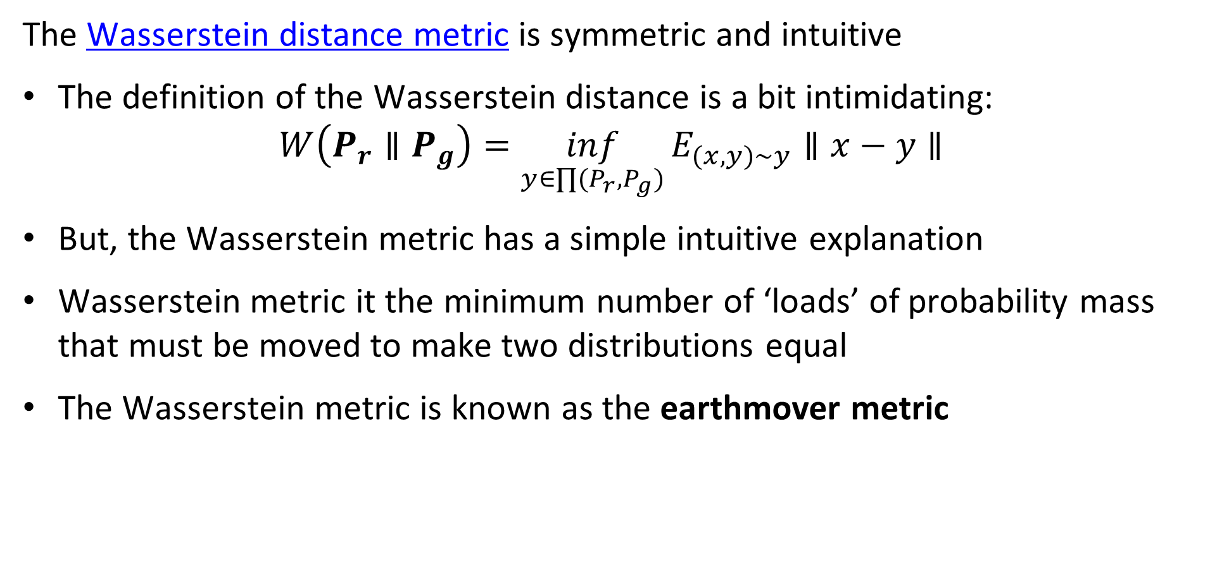
The Wasserstein distance metric
The Wasserstein distance metric is symmetric and intuitive
The definition of the Wasserstein distance is a bit intimidating:
$$W\left(P_{r}∥P_{g}\right)=\inf_{y∈∏(P_{r},P_{g})}{E_{(x,y)∼y}∥x−y∥}$$
But, the Wasserstein metric has a simple intuitive explanation
Wasserstein metric it the minimum number of ‘loads’ of probability mass that must be moved to make two distributions equal
The Wasserstein metric is known as the earthmover metric

Slide 44
The Wasserstein distance metric
How many earthmover loads are required to equalize the distributions?
4
4
4
4
Q(x)
3
3
3
3
2
2
2
2
1
1
1
1
0
1
2
3
4
0
1
2
3
4
0
1
2
3
4
0
1
2
3
4
4
4
4
4
3
3
3
3
P(x)
2
2
2
2
1
1
1
1
0
1
2
3
4
0
1
2
3
4
0
1
2
3
4
0
1
2
3
4
0 loads
1 load
2 loads
3 loads

Slide 45
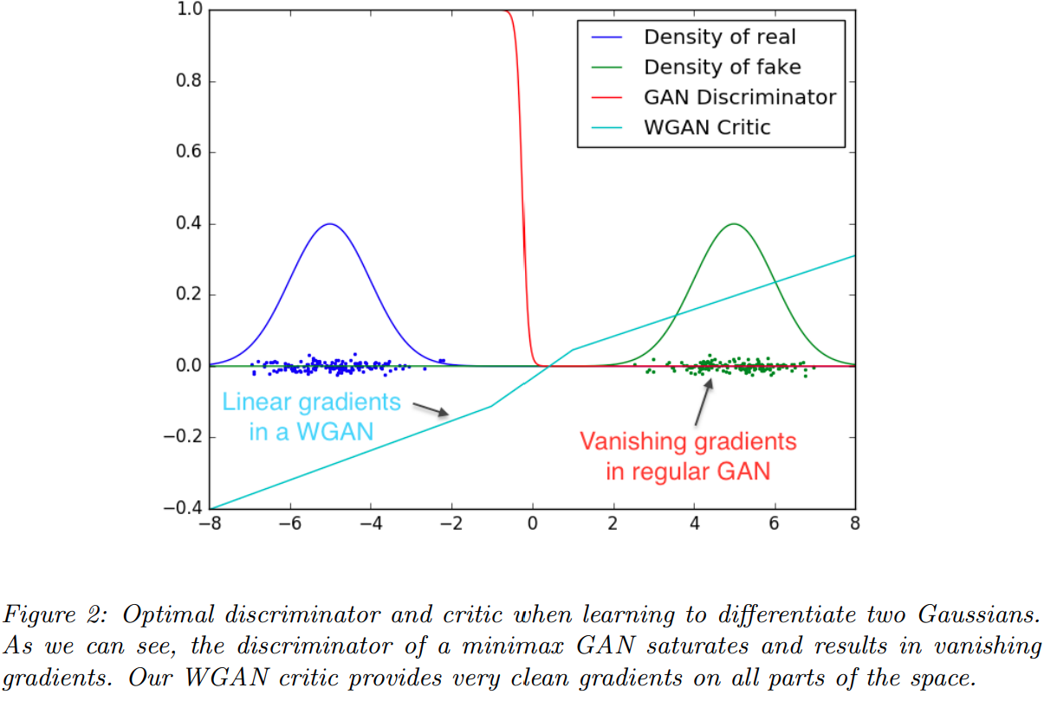
The Wasserstein distance metric
The loss of the Wasserstein GAN is linear and symmetric
The KL divergence of the real and generated data can be discontinuous and have 0 derivatives
The Wasserstein loss has linear gradient

Slide 46
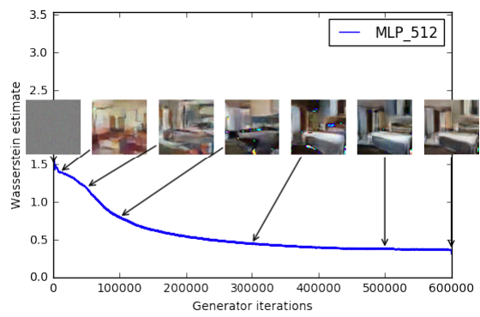
The Wasserstein distance metric
The loss of the Wasserstein GAN is linear and symmetric
Image generation starts with random noise
As generator loss is reduced, the images create improve
Notice that learning continues as loss function continues to decrease

Slide 47
Evaluation of GAN Models

Slide 48
Evaluation of GANs
Need an objective metric for evaluation of GAN models
Early GAN research inhibited by use of only subjective human judgement
Need an objective evaluation metric that agrees with human judgement of generated image quality
Inception score was proposed by Salimans, et. al., 2016
Fréchet Inception distance proposed by Heusel, et. al., 2017 is an improvement on inception score

Slide 49
Evaluation of GANs
Inception score attempts to balance accuracy at creating real objects and diversity of objects created
Inception score is based on classifications by the pre-trained Inception Network
GANs should produce object images that closely resemble real-world objects
Inception should clearly recognize objects
Classification probabilities should have only one high value
Poorly recognized objects have indeterminant probabilities
GANs should produce a diversity of objects – not the same few many times
Should be a nearly uniform distribution of probability of occurrence of each recognized object class

Slide 50
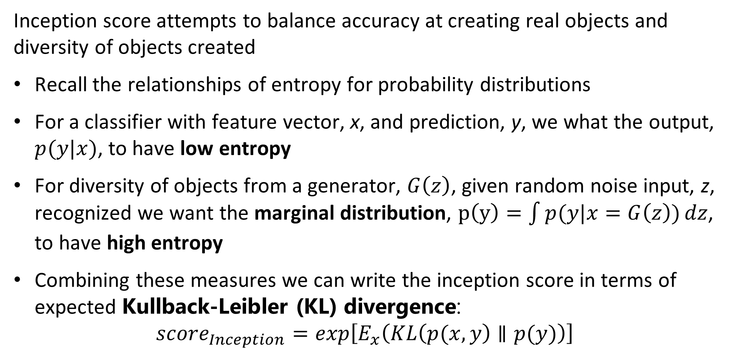
Evaluation of GANs
Inception score attempts to balance accuracy at creating real objects and diversity of objects created
Recall the relationships of entropy for probability distributions
For a classifier with feature vector, x, and prediction, y, we what the output, $p(y|x)$, to have low entropy
For diversity of objects from a generator, $G\left(z\right)$, given random noise input, z, recognized we want the marginal distribution, $p\left(y\right)=\int{p(y|x=G\left(z\right))}dz$, to have high entropy
Combining these measures we can write the inception score in terms of expected Kullback-Leibler (KL) divergence:
$${score}_{Inception}=exp\left[E_{x}\left(KL\left(p(x,y\right)∥p(y)\right)\right]$$

Slide 51
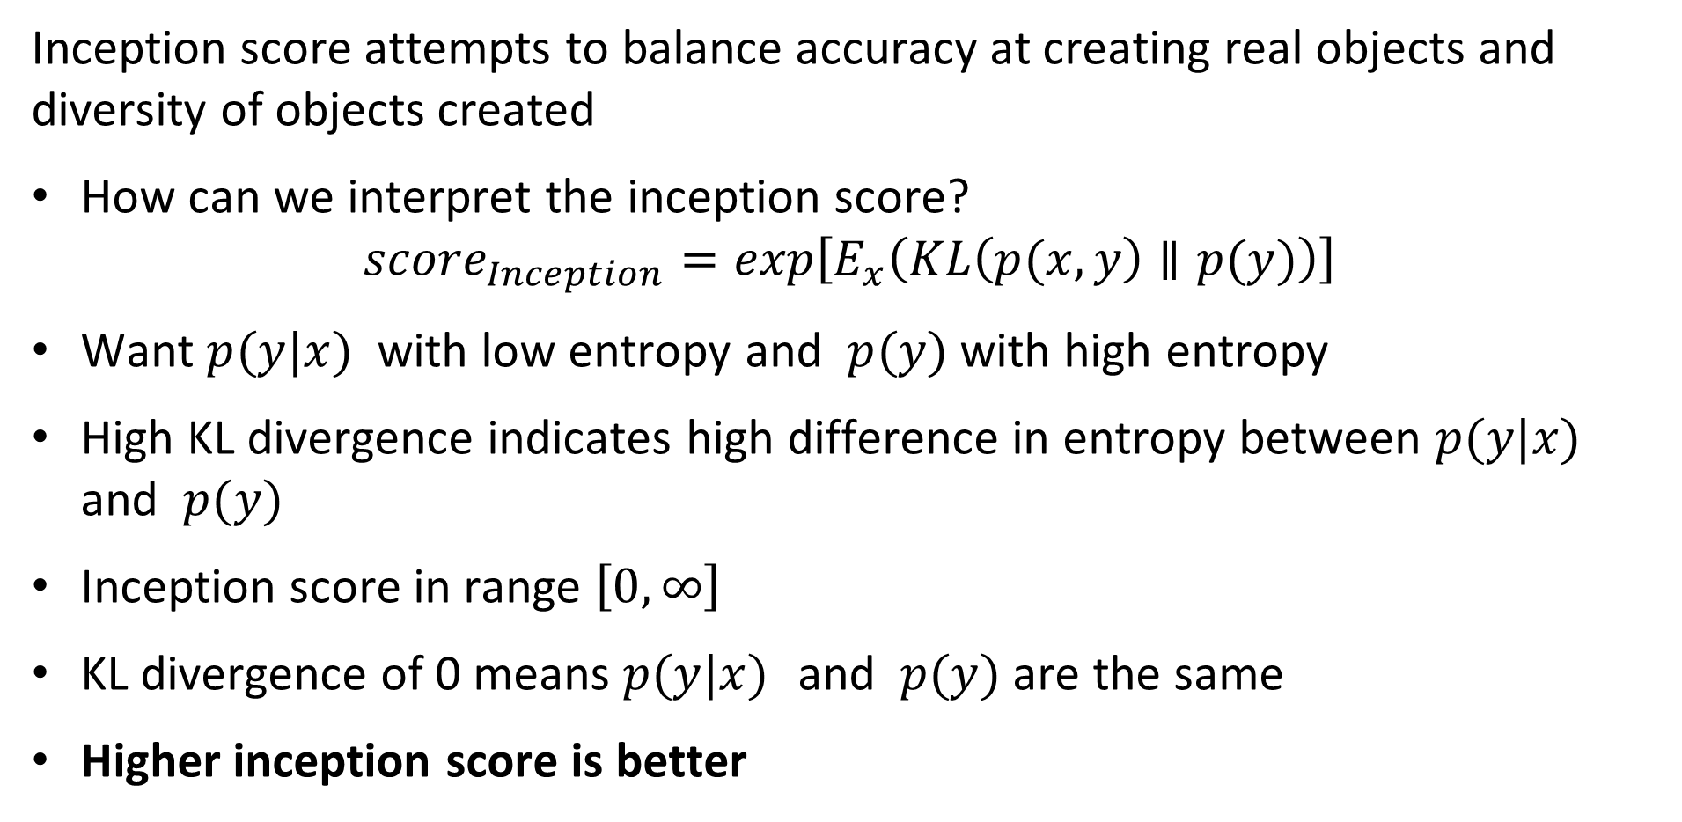
Evaluation of GANs
Inception score attempts to balance accuracy at creating real objects and diversity of objects created
How can we interpret the inception score?
$${score}_{Inception}=exp\left[E_{x}\left(KL\left(p(x,y\right)∥p(y)\right)\right]$$
Want $p(y|x)$ with low entropy and $p(y)$ with high entropy
High KL divergence indicates high difference in entropy between $p(y|x)$ and $p(y)$
Inception score in range $\left[0,∞\right]$
KL divergence of 0 means $p(y|x)$ and $p(y)$ are the same
Higher inception score is better

Slide 52
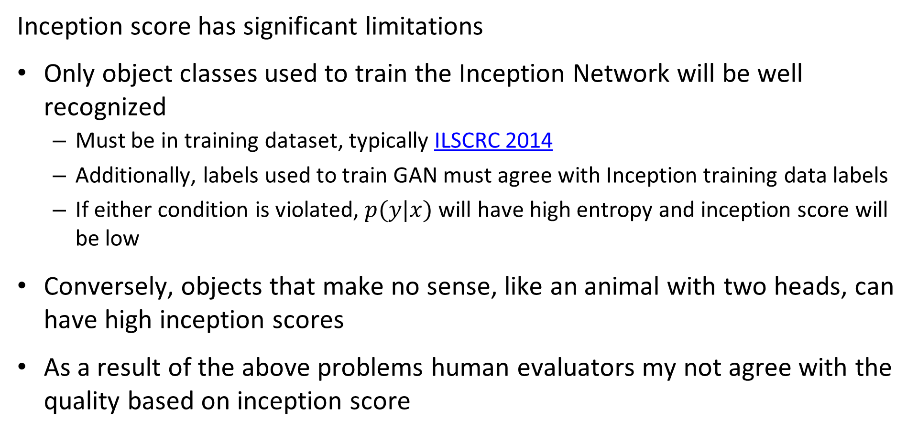
Evaluation of GANs
Inception score has significant limitations
Only object classes used to train the Inception Network will be well recognized
Must be in training dataset, typically ILSCRC 2014
Additionally, labels used to train GAN must agree with Inception training data labels
If either condition is violated, $p(y|x)$ will have high entropy and inception score will be low
Conversely, objects that make no sense, like an animal with two heads, can have high inception scores
As a result of the above problems human evaluators my not agree with the quality based on inception score

Slide 53
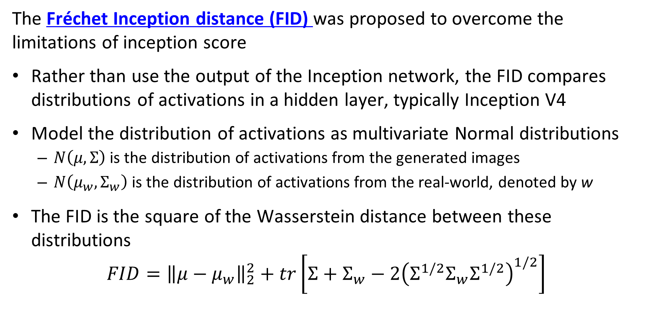
Evaluation of GANs
The Fréchet Inception distance (FID) was proposed to overcome the limitations of inception score
Rather than use the output of the Inception network, the FID compares distributions of activations in a hidden layer, typically Inception V4
Model the distribution of activations as multivariate Normal distributions
$N\left(μ,Σ\right)$ is the distribution of activations from the generated images
$N\left(μ_{w},Σ_{w}\right)$ is the distribution of activations from the real-world, denoted by w
The FID is the square of the Wasserstein distance between these distributions
$$FID={\left\|μ−μ_{w}\right\|}_{2}^{2}+tr\left[Σ+Σ_{w}−2{\left(Σ^{1/2}Σ_{w}Σ^{1/2}\right)}^{1/2}\right]$$

Slide 54
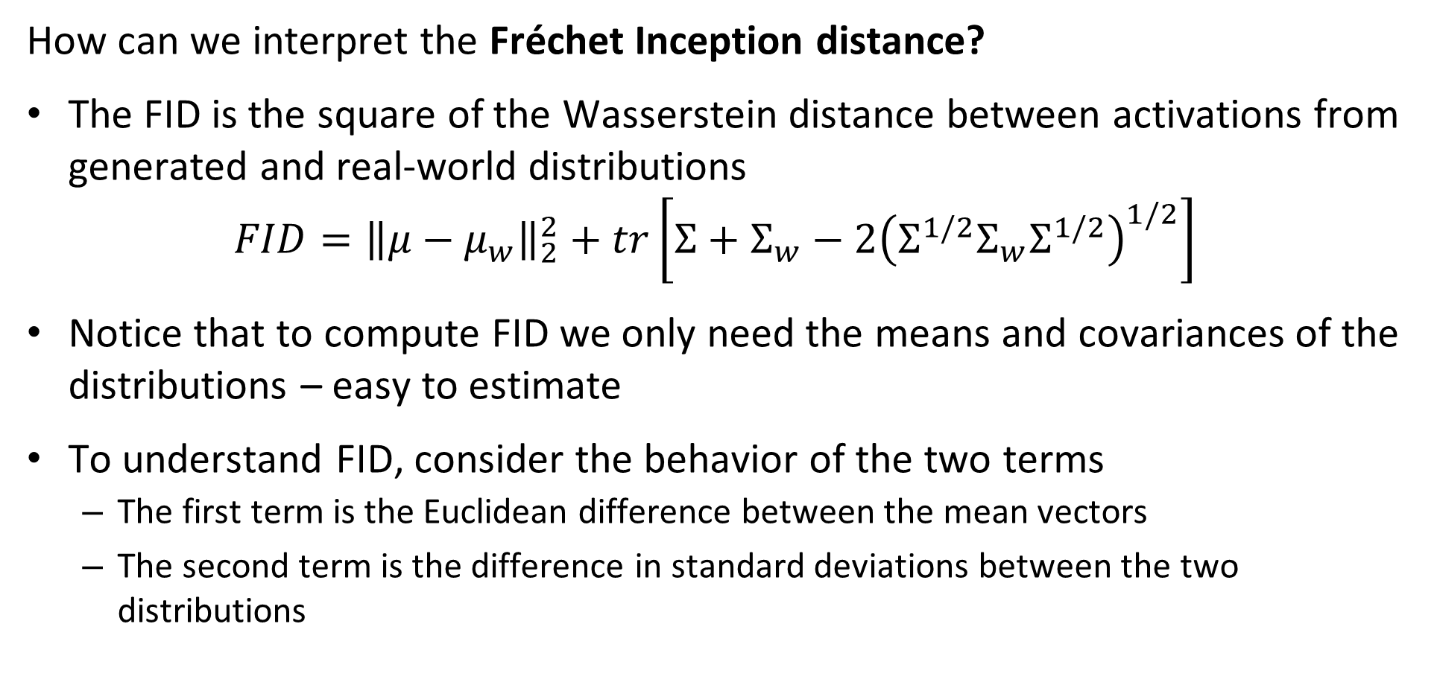
Evaluation of GANs
How can we interpret the Fréchet Inception distance?
The FID is the square of the Wasserstein distance between activations from generated and real-world distributions
$$FID={\left\|μ−μ_{w}\right\|}_{2}^{2}+tr\left[Σ+Σ_{w}−2{\left(Σ^{1/2}Σ_{w}Σ^{1/2}\right)}^{1/2}\right]$$
Notice that to compute FID we only need the means and covariances of the distributions – easy to estimate
To understand FID, consider the behavior of the two terms
The first term is the Euclidean difference between the mean vectors
The second term is the difference in standard deviations between the two distributions

Slide 55
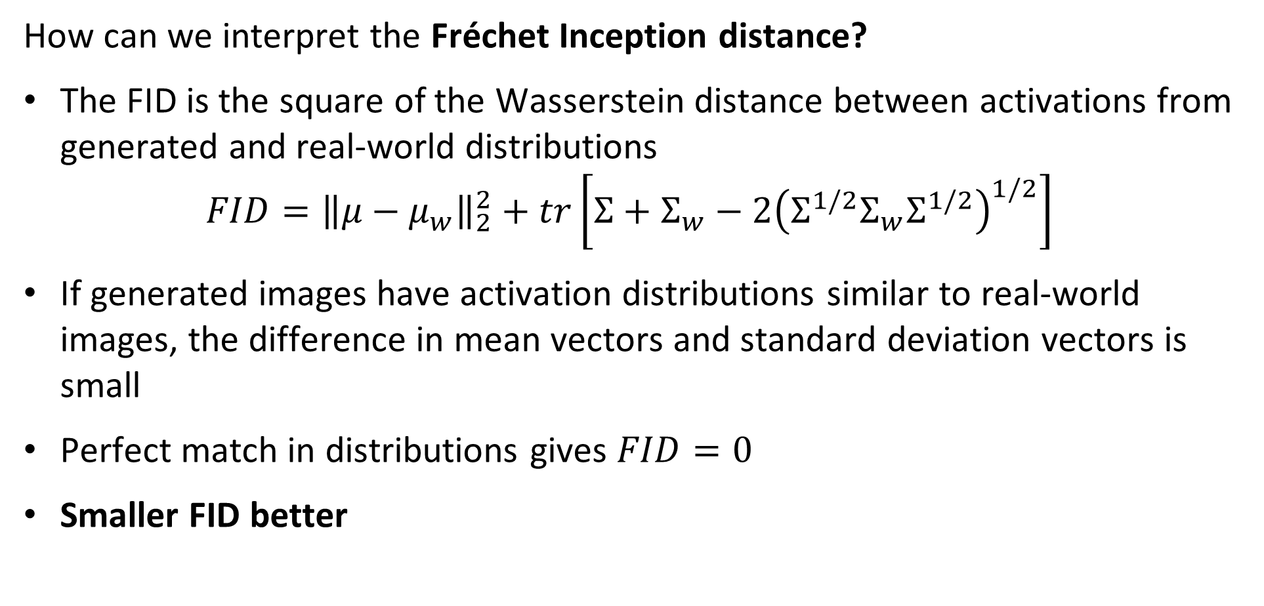
Evaluation of GANs
How can we interpret the Fréchet Inception distance?
The FID is the square of the Wasserstein distance between activations from generated and real-world distributions
$$FID={\left\|μ−μ_{w}\right\|}_{2}^{2}+tr\left[Σ+Σ_{w}−2{\left(Σ^{1/2}Σ_{w}Σ^{1/2}\right)}^{1/2}\right]$$
If generated images have activation distributions similar to real-world images, the difference in mean vectors and standard deviation vectors is small
Perfect match in distributions gives $FID=0$
Smaller FID better

Slide 56
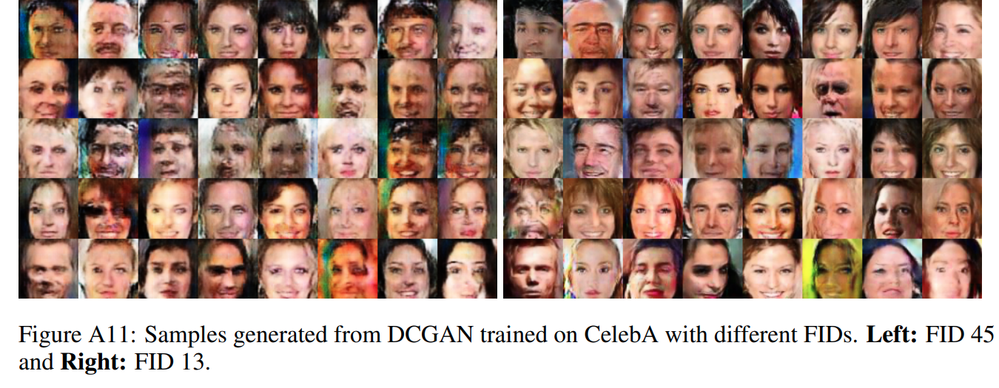
Evaluation of GANs
Example of Fréchet Inception distance – agrees with human perception

Slide 57
Advances in GAN Models

Slide 58
Approaches to improved GAN training
A great deal of research has focused on improving the convergence and preventing mode collapse
An very incomplete list of key advances:
Method | Approach | Year
Deep Convolutional GANs - DC-GANs | Use fully convolutional representation | 2014
Conditional GAN | Use conditional distribution to generate specific images | 2014
Multiple ad-hoc methods, Salimans, et. al., 2016 | Minibatch mixing, virtual batch normalization, and feature matching – Rarely used now days, beyond inception score | 2016
Wasserstein GAN | Use Wasserstein loss for training | 2017
Two-time scale updates | Use different time scales for generator and discriminator training | 2018
Spectral Normalization – SN-GANs | Scale weights so largest eigenvalue to 1.0 | 2018
Self Attention GAN - SAGAN | Use an self attention mechanism to train latent space | 2019
Style-based GAN | Generator uses attention on specific parts of the latent space to create desired style, see Karras, et.al., 2018 for details | 2018

Slide 59
The Conditional GAN
For conditional GAN image generated is conditional on an exogenous variable
Conditional GAN introduced by Mirza and Osindero, 2014
Image generation in unconditional GANs is constrained
Unconstrained GAN produces inconsistent results
An early advance in making GANs practical
Using conditioning variable constrains generation of images
Idea used in many modern architectures

Slide 60
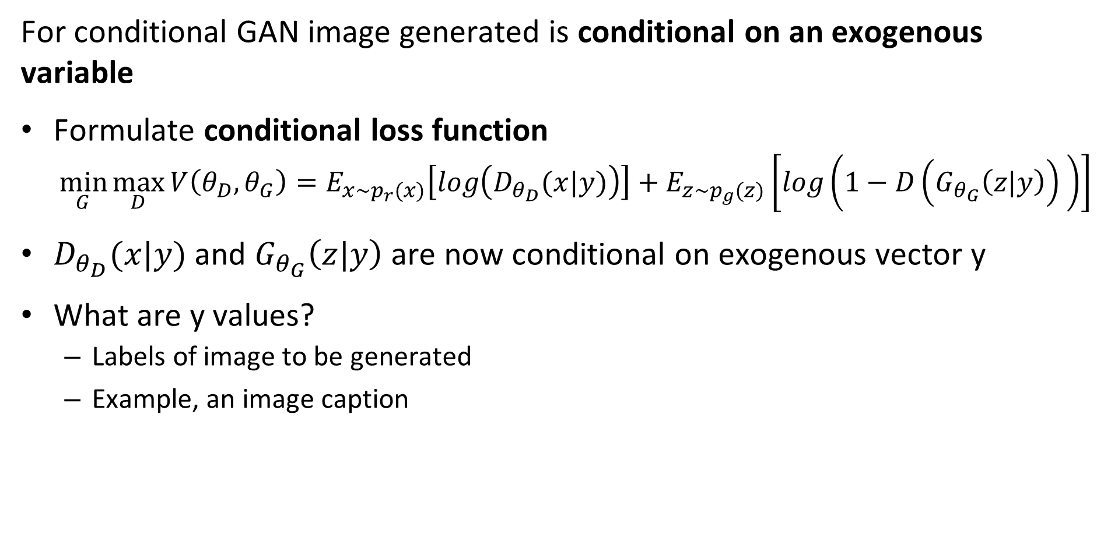
The Conditional GAN
For conditional GAN image generated is conditional on an exogenous variable
Formulate conditional loss function
$$\min_{G}{\max_{D}{V\left(θ_{D},θ_{G}\right)=E_{x\sim p_{r}(x)}\left[log\left(D_{θ_{D}}(x|y)\right)\right]+E_{z\sim p_{g}(z)}\left[log\left({1−D\left(G_{θ_{G}}\left(z|y\right)\right)}_{ }\right)\right] }}$$
$D_{θ_{D}}(x|y)$ and $G_{θ_{G}}\left(z|y\right)$ are now conditional on exogenous vector y
What are y values?
Labels of image to be generated
Example, an image caption

Slide 61



The Conditional GAN
For conditional GAN image generated is conditional on an exogenous variable
Conditional discriminator function $D\left(z|y\right)$
Concatenated real and fake data vectors, x
Exogenous variable vector, y
Conditional generator function $D\left(x|y\right)$

Slide 62

The Conditional GAN
For conditional GAN image generated is conditional on an exogenous variable
Examples of tags and conditional image generation
Mirza and Osindero, 2014

Slide 63

The Convolutional GAN
The deep convolutional GAN is a fully convolutional
The deep convolutional GAN or DCGAN (Radford, et. al. 2015) was a significant breakthrough in creating GAN model with stable training behavior
Fully convolutional architecture – no fully connected layers

Slide 64
The Convolutional GAN
Components of the DCGAN,
Convolutional Embedding Space
Increasing image resolution
Random Input vector

Slide 65

The Convolutional GAN
Can perform linear mathematical operations on convolutional embedding space

Slide 66
GANs trained with two time scales
Heusel, et. al, 2018, use two time scale update rule (TTUR) train the discriminator and generator
Observer that simple generator-discriminator training may only converge to a local Nash equilibrium – no global convergence guarantee
Discriminator learns too fast
Discriminator learns to tell real from generated data
Generator is prevented from further learning
Solution, limit learning rates to guarantee convergence toward global Nash equilibrium
Heusel, et. al, 2018 also introduced the Fréchet Inception distance

Slide 67

GANs trained with TTUR
TTUR uses different stochastic learning rates to train the discriminator and generator
Details are quite technical
Solution, limit learning rates to guarantee convergence toward global Nash equilibrium for discriminator, D(.; w), and generator, G(.; θ)
TTUR uses learning rates b(n) and a(n), gradients $g\left(θ_{n},w_{n}\right)$ and$h\left(θ_{n},w_{n}\right)$, and random variables $M_{n}^{(w)}$and$M_{n}^{(θ)}$, for the discriminator and the generator update:
$$w_{n+1}=w_{n}+b(n)\left[g\left(θ_{n},w_{n}\right)+M_{n}^{(w)}\right]$$
$$θ_{n+1}=θ_{n}+b(n)\left[h\left(θ_{n},w_{n}\right)+M_{n}^{(θ)}\right]$$

Slide 68

GANs trained with TTUR
TTUR uses different stochastic learning rates to train the discriminator and generator

Slide 69
Spectral normalization of weights
Many types of regularization have been tried for GANs
Weight clipping, L1 regularization, L2 regularization, batch/weight normalization, dropout regularization
Regularization often inhibits learning by discriminator
Miyato, et. al., 2018, applied spectral normalization to create the SN-GAN algorithm - a quite technical, but interesting, paper
SN-GAN algorithm employs TTUR rule along with spectral normalization for training discriminator and generator

Slide 70

Spectral normalization of weights
Spectral normalization attempts to create smooth or bounded gradient
A function, f(x), is said to have K-Lipschitz continuity for any x and x’, given the Euclidian or L2 norm:
$$\frac{∥f\left(x\right)−f(x^{′})∥}{∥x−x′∥}≤K$$
A function with a discontinuous derivative cannot have K-Lipschitz continuity
Requiring a function to have K-Lipschitz continuity is a form of regularization

Slide 71

Spectral normalization of weights
Spectral normalization attempts to create smooth or bounded gradient
A function, f(x), is said to have K-Lipschitz continuity for any x and x’, given the Euclidian or L2 norm:
$$\frac{∥f\left(x\right)−f(x^{′})∥}{∥x−x′∥}≤K$$
We can express the 1-Lipschitz continuity for a NN weight matrix, W, in terms of its spectral norm, $σ\left(W\right)$:
$$σ\left(W\right)=\max_{h:h≠0}{σ\left(\frac{∥Wh∥}{∥h∥}\right)}=\max_{∥h∥≤1}{σ\left(∥Wh∥\right)}$$

Slide 72

Spectral normalization of weights
Spectral normalization attempts to create smooth or bounded gradient
The spectral norm of a weight matrix W, $σ\left(W\right)$, is the magnitude of its largest singular value, for the singular value decomposition (SVD):
W$=UΣV$
Using the first left and right singular vectors, $u_{1}$ and $v_{1}$, we can compute the largest singular value of W, and hence spectral (matrix) norm
$$σ\left(W\right)=u_{1}^{T}Wv_{1}{ }$$
We can efficiently compute the first singular values by the power iteration algorithm
For details see, for example, Section 11.1 of Mining Massive Datasets, Leskovec, et.al., 2020

Slide 73

Spectral normalization of weights
The stochastic gradient descent (SGD) algorithm for SN-GAN is straight forward

Slide 74

Spectral normalization of weights
Comparing inception scores of GAN models for different ADAM optimizer hyperparameters

Slide 75

Spectral normalization of weights
Comparison of squared largest singular values for several regularization methods

Slide 76
Self-attention GAN
Images of real-world scenes have a significant spatial extent
Convolutional operators used to create an embedding (latent) space have a small spatial extent – receptive field
As a result of only local sensitivity, convolutional GANs are poor at creating many types of scenes
Wang, et. al., 2017, develop a non-local neural network algorithm using a self-attention mechanism which gives superior performance for several tasks
Zhang, et. al., 2019, applied non-local self-attention to training GANs

Slide 77

Self-attention GAN
Images of real-world scenes have a significant spatial extent
Non-local self-attention adds non-local behavior to GAN training
Non-local self-attention applied to both discriminator and generator
Start with two latent feature spaces, $f\left(x\right)=W_{f}x$ and g$\left(x\right)=W_{g}x$ for hidden layer activation x
$W_{f}$ and $W_{g}$ and learnable weight tensors
Interaction between the latent spaces computed as the inner product
$$s_{i,j}={f\left(x_{i}\right)}^{T}g\left(x_{i}\right)$$

Slide 78

Self-attention GAN
Images of real-world scenes have a significant spatial extent
Interaction between the latent spaces computed as the inner product
$$s_{i,j}={f\left(x_{i}\right)}^{T}g\left(x_{i}\right)$$
The extent the model attends to location i when synthesizing location j is then:
$$β_{i,j}=\frac{exp\left(s_{i,j}\right)}{\sum_{i}{exp\left(s_{i,j}\right)}}$$
Attention probability is determined by the softmax activation $β_{i,j}$

Slide 79

Self-attention GAN
Images of real-world scenes have a significant spatial extent
The extent the model attends to location i when synthesizing location j, $β_{i,j}$
Output of attention layers is $o=\left(o_{1},o_{2,}…o_{n}\right)$, with learnable weight tensors, $W_{ν}$ and $W_{h}$:
$$o_{j}=ν\sum_{i=1}^{n}{β_{i,j}h\left(x_{i}\right)}, ν\left(x_{i}\right)=W_{ν}x_{i}, h\left(x_{i}\right)=W_{h}x_{i}$$
And the output of the GAN, , given learnable parameter, $γ$, is:
$$y_{i}=γo_{j}+x_{i}$$

Slide 80

Self-attention GAN
Architecture of SA-GAN

Slide 81

Self-attention GAN
Convergence properties of SA-GANs

Slide 82

Self-attention GAN
128x128 images generated by SA-GAN – FID of SA-GAN and SN-GAN shown

